Slide 1
Lessons from Typhoon Haiyan:
Supporting shelter self-recovery in the Philippines
How did the programmes measure success?
Victoria Maynard, Elizabeth Parker
http://promotingsaferbuilding.org/projects/lesson-from-haiyan

Slide 2
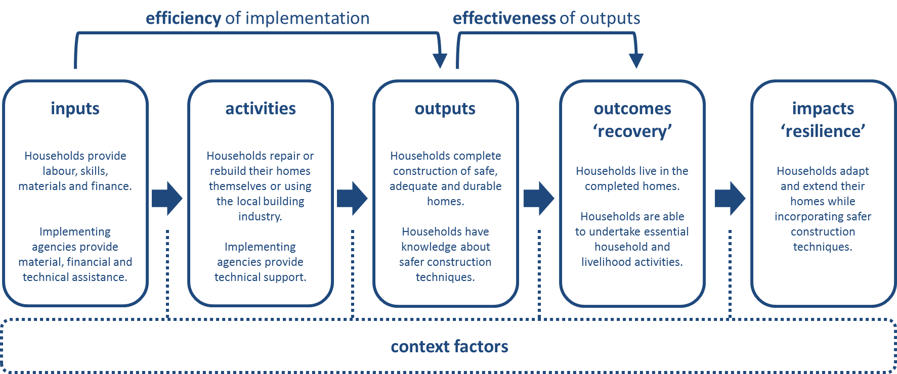
First… a theory of change
‘one or a combination of material, financial and technical assistance, during the relief and/or recovery phase, to enable affected households to repair, build or rebuild their own shelters themselves or through using the local building industry’
‘to be accurately described as ‘self-recovery’,
the post-disaster shelter reconstruction process
must be driven by the householder’

Slide 3
Output measures (shelters + knowledge)
Completion rates of shelters
Incompletion rates (or dropouts) ranged from 3 to 60 per cent
According evaluators 92 per cent of shelters were ‘adequate’ but ‘almost everyone says that their houses are not complete’.
Size, safety and durability of shelters
Technical assessment of building elements (foundations, walls, etc.) with rating (good, fair, poor, very poor).
Households reported ‘having more space and comfort’ but technical assessment found ’94 per cent of roofs weak or very weak’.
Beneficiary perception of ‘Safe, adequate, durable’.
Household knowledge of BBS techniques
Knowledge of BBS techniques – immediately after training, at a later date.
Application of the techniques in practice.

Slide 4
Outcome measures (recovery)
Perception of safety and security
Beneficiaries reported ‘feeling safer’… except in ‘low-land, more peri-urban barangays where previously houses had been largely built of concrete blocks’.
Income, expenditure, assets of debts
‘reduced expenses in home repairs’
Tools and materials added to household assets
Income can be used for food, healthcare or education
Physical and mental health
‘sleeping better’
Relief from post-traumatic stress
Dignity, empowerment and self-reliance
Pride in learning and what they had achieved. Being able to take charge.

Slide 5
In general
There was no consistent set of indicators used by the different agencies to measure project outputs or outcomes, nor a consistent approach or methodology.
Critical differences between agencies included: what was evaluated; the timing of the evaluation; and whether the evaluation included a technical assessment or relied on beneficiary perception.
If you do a technical assessment what do you compare to? Pre-disaster situation, pre-disaster standards, sphere standards, shelter cluster standards?

Slide 6
Finally… a comment
Number of households provided with x, y, z
Number of completed shelters

Slide 7
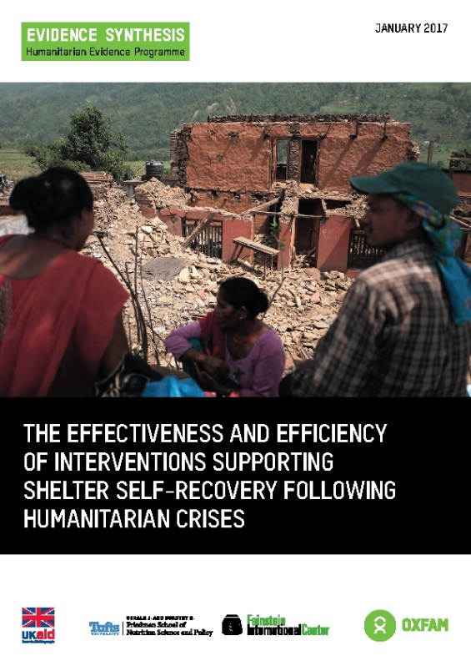

Further information
Maynard, V., Parker, E., Twigg, J. (2017)
The effectiveness and efficiency of interventions
supporting shelter self-recovery following
humanitarian crises: An evidence synthesis.
http://promotingsaferbuilding.org/projects/supporting-shelter-self-recovery-evidence-synthesis
Maynard, V. & Parker, E. (2018)
Supporting Shelter Self-Recovery:
Lessons from Super Typhoon Haiyan
http://promotingsaferbuilding.org/projects/lesson-from-haiyan
victoria.c.maynard@gmail.com
@vcmaynard

