Slide 1
Sectors or Sectorial Expertise?
Housing, Land and Property (HLP)

Slide 2
Do we need Sectors or not?
Wrong Question
The question should rather be how different sectorial expertise can be combined and coordinated into comprehensive program responses
There is a need for organizations and individuals to have deep sectorial competence in order to do a good job
The challenge for any NGO is how to combine various sectoral expertise to useful solutions/responses

Slide 3
City of London
Notes:
City of London has various experts:
Traffic management, sewage treatment, health etc. and is able to offer a quite comprehensive package to its citizen.
The city of London does not just giving people tax cuts and let them find solutions themselves expecting an optimal outcome.
Somebody actually needs to provide technical expertise and someone else needs to understand how to combine, sequence and manage the expertise in order to maximize functionality from both the technical side and the user side
Somebody also needs to communicate how the systems function to the end user, gather and collect information on highest priorities and decide on mechanisms to finance the most important elements
This is NGO programming at a glance

Slide 4
Housing, Land and Property
HLP is a technical expertise needed in order to ensure that shelter solutions are not a standalone product but part of a wider and comprehensive solution
We all know:
Shelter is more than bricks and mortar
Site management, governance, environment, gender, participation, livelihood, access to social and technical infrastructure etc. are key elements of our comprehensive response
But the legal dimension to the mix is rather new and arguably not yet fully part of the DNA of shelter.
HLP dimensions of other sectors are also more common and it shows the interlinkages between sectors – referring back to the need of needed sectorial expertise

Slide 5
2016 HRP Review
The Housing, Land and Property Area of Responsibility under the Global Protection Cluster undertook a review of 18 Humanitarian Response Plans for 2016 to identify the level of integration of housing, land and property (HLP) issues into planned humanitarian interventions
Findings:
Overall a large number of protection responses refer explicitly to HLP or to aspects of HLP
Many shelter and CCCM responses identify HLP as a specific issue to address
Access and availability of land is also often mentioned in relation to food security, agriculture and/or livelihood responses.
Land is also linked to early recovery and mine action.
Notes:
- The Housing, Land and Property Area of Responsibility under the Global Protection Cluster undertook a review of 18 Humanitarian Response Plans for 2016 to identify the level of integration of housing, land and property (HLP) issues into planned humanitarian interventions
- The review found that overall a large number of protection responses refer explicitly to HLP or to aspects of HLP (access to land or housing) and many shelter and CCCM responses identify HLP as a specific issue to address. In addition, access and availability of land is also often mentioned in relation to food security, agriculture and/or livelihood responses. Finally land is also linked to early recovery and mine action.
- It can be concluded from the review that HLP considerations are well integrated into the 2016 Humanitarian Response Plans – NGO programming needs to fully make this part of their DNA – see below for the list of response plans that include HLP

Slide 6
2016 HRP Review
It can be concluded from the review that HLP considerations are well integrated into the 2016 Humanitarian Response Plans
NGO programming needs to fully make this part of their DNA

Slide 7
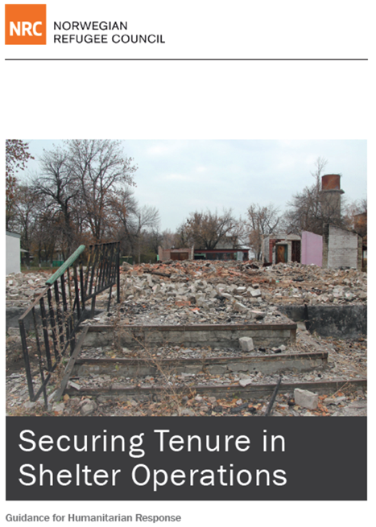
Part of NRC’s efforts to develop an operational definition of security of tenure applicable in humanitarian settings
Incorporates learning from field operations as they apply basic concepts of tenure security together with knowledge of the local context to devise shelter solutions based on the legal realities and the diversity of tenure systems and tenure forms in place.
NRC strives to promote the design of flexible solutions with tenure that is secure enough, namely provides the greatest degree of protection for beneficiaries that is feasible in the context.
Notes:
Despite this operational reality, until recently, both donors and shelter agencies have largely adhered to traditional notions of providing shelter solutions based on individual property ownership, given the view that this was the only sufficiently secure form of tenure
As a result, people lacking individual ownership – often among the most vulnerable – were excluded from shelter solutions.
IN response to this operational reality, NRC developed Shelter Tenure Guidelines which are part of NRC’s efforts to develop an operational definition of security of tenure applicable in humanitarian settings, which will enable the organisation to effectively address the shelter needs of its beneficiaries.
It incorporates learning from field operations as they apply basic concepts of tenure security together with knowledge of the local context to devise shelter solutions based on the legal realities and the diversity of tenure systems and tenure forms in place.
- In this way, NRC strives to promote the design of flexible solutions with tenure that is secure enough, namely provides the greatest degree of protection for beneficiaries that is feasible in the context.
- On the one hand is the ideal of formal tenure with a high degree of security evidenced by official documents.
- On the other, the immediate need of beneficiaries for some security in a situation where formal documented tenure is difficult to obtain.
- The document and the related HLP for shelter training present operational efforts in a range of contexts to find the right balance, using tenure options for beneficiaries short of private ownership, with emphasis on how tenure can be secured and documented in the absence of rules or documentation issued by formal authorities.
- Going forward, one goal is to continue to explore options for the use of additional forms of tenure.

Slide 8
NRC Shelter-HLP ToT
Training facilitated by: Jim Kennedy
Open to SAG agencies and the wider Shelter Cluster agencies
Key topics to be covered:
Contextualising the ToT training to local needs and responses
Engagement of local actors, including local authorities
Making the training relevant to multi-sectoral approaches
Facilitation of key example sessions from the training.

Slide 9
NRC Shelter-HLP ToT
Wednesday, 14th December 2016
Geneva, Switzerland
Please contact Neil Brighton for further information:
Neil.brighton@nrc.no
In email please include interested party’s general profile, and reasons for attending.
Deadline for expression on interest: 1st December 2016.

