Slide 1
Addressing the Socio-Economic Gaps in Post-disaster Rental Support Programs Alex Miller Oxford Brookes 2016
HAITI 1 year subsidized rental support program+ protection, social welfare, construction improvements, livelihoods IDP Natural Disaster
LEBANON Hosting support rental program + protection + social welfare + construction improvements, livelihoods, Refugee, Conflict
3-month in-field research June to August 2016 2016 USAID/OFDA Shelter and Resettlements Fellowship

Slide 2
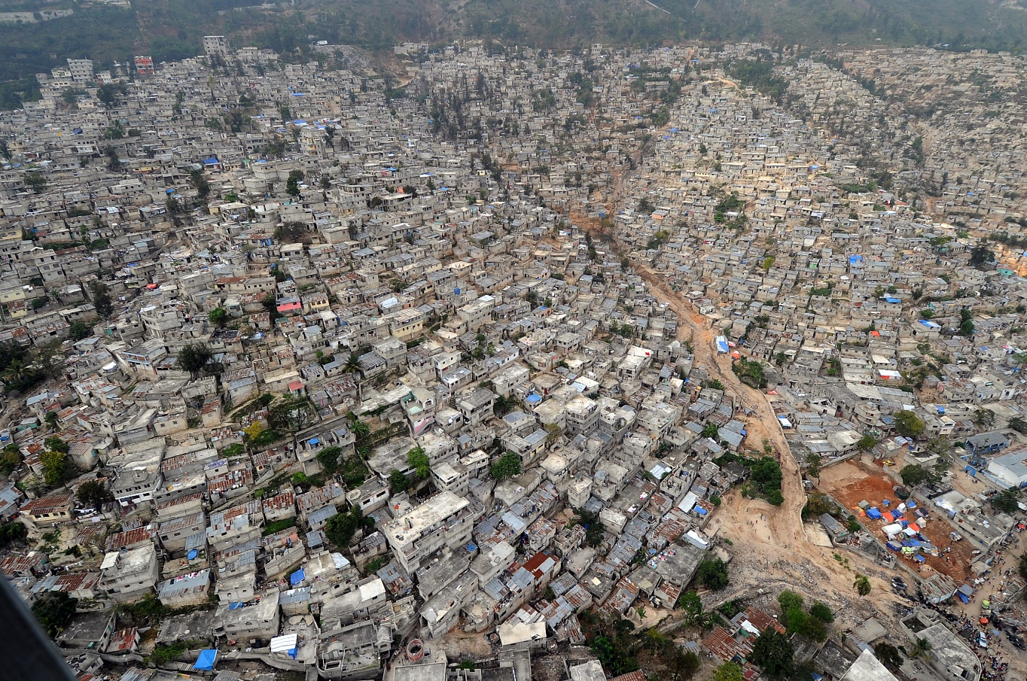
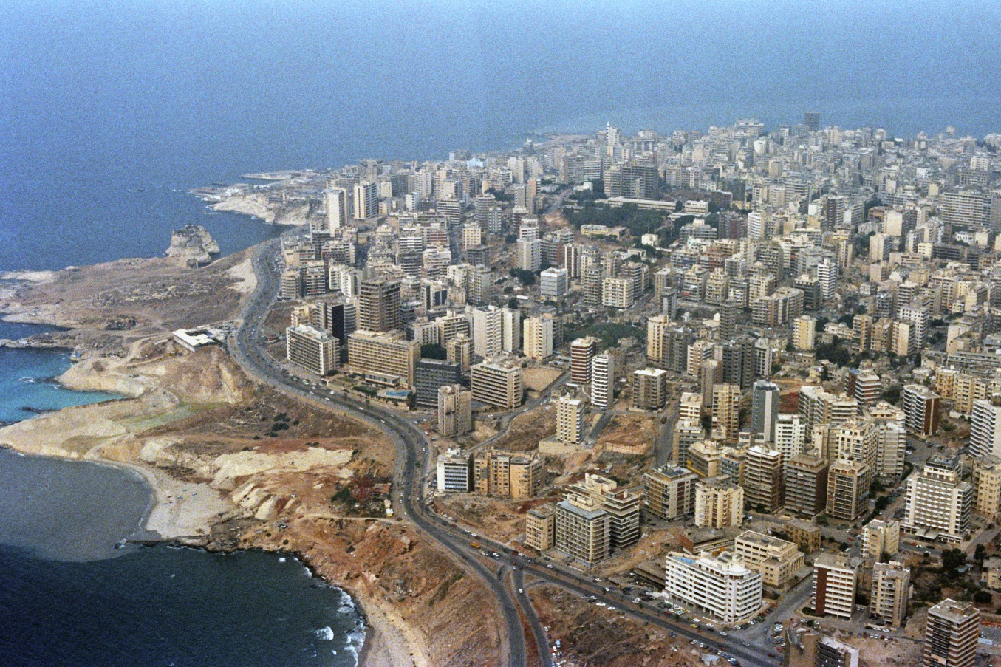
Haiti - Negotiated rent, value added services
Lebanon- Assisting the landlord to host a family, incentives
With over a million internally displaced persons in Port-au-Prince after the 2010 earthquake, and over a million Syrian Refugees forced to migrate to Beirut from the ongoing Syrian civil war, why was a rental or hosting program chosen to house the most vulnerable?

Slide 3
Primary Research Questions and findings:
Once a rental support or hosting program is implemented, what are the determining factors which can influence for how long, or even if a family can continue to rent or be hosted after the aid is finished?
?
?

Slide 4
Primary Research Questions and findings:
Renters make a social and financial contract to have access to another persons asset or house. The amount of sustainable rent paying income, and the amount of trust between the renter, owner, community or government can influence the renter to whether they can continue to live in a safe and durable housing solution.
trust
income

Slide 5
How is trust built?
Social impact pre-project assessment (will people trust these renters or lodgers?) Social groups can create conflict with differences in origin, income, religion, culture, gender, age, prior living situation, as well as language. (Protection working group)
Share the outcomes of subsidized rent (everybody wants something) Invest in community projects, infrastructure improvements, social programs, broaden the aid to include households who are not as vulnerable, or even transform their view of a renter from a short-term cash source, to a long-term asset
Meet and Greet (understanding can ease tensions) Simply bringing renters or persons being hosted together with other stakeholders can decrease stereotypes, and lower misguided negative assumptions

Slide 6
How is income built?
Assess the livelihoods(do they need new skills, or is their income reliable?) To pay the rent, there has to be a market which can support a job, where do they find one? Can rental support programs encourage educational access for better employment? Is it too competitive?
Mirco-finance programs (financial assistance) Paying rent requires financial planning, and local programs can support that
Industry, and partnering with existing programs (Are there labour unions, policies, or frameworks in place to support income generating activities?

Slide 7
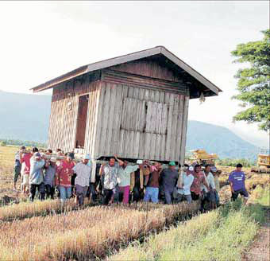
Shelter as an integrated response...

