Slide 1
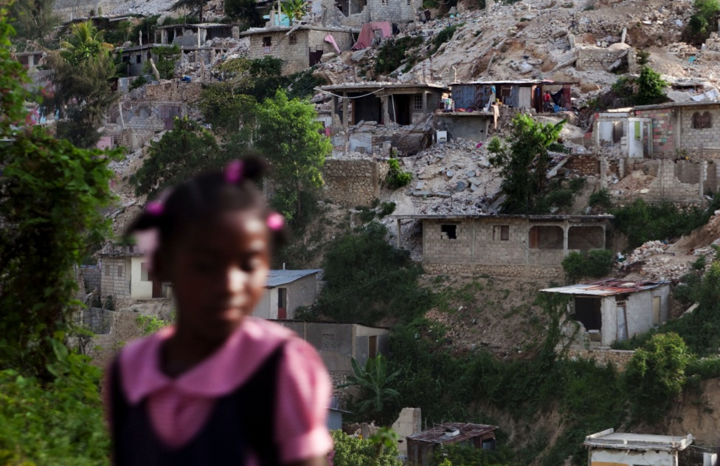

CORDAID
DISASTER RESILIENCE + URBAN MATTERS
SHELTER2HABITAT STRATEGY
SHELTER2HABITAT
Developing resilient habitats after a disaster
CARE ACT SHARE. LIKE CORDAID
Caption
CREDITS: XXXXX
Jan-Willem Wegdam, April 2015

Slide 2
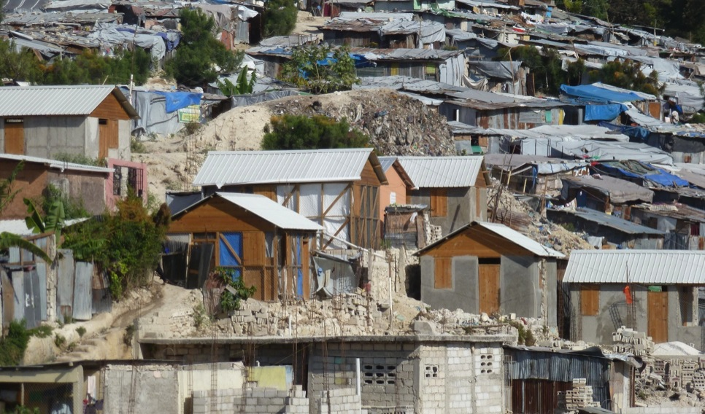
1. PREFACE
Disasters provide a window of opportunity to build more resilient habitats
Caption
CREDITS: XXXXX
Shelter2Habitat April 2015

Slide 3
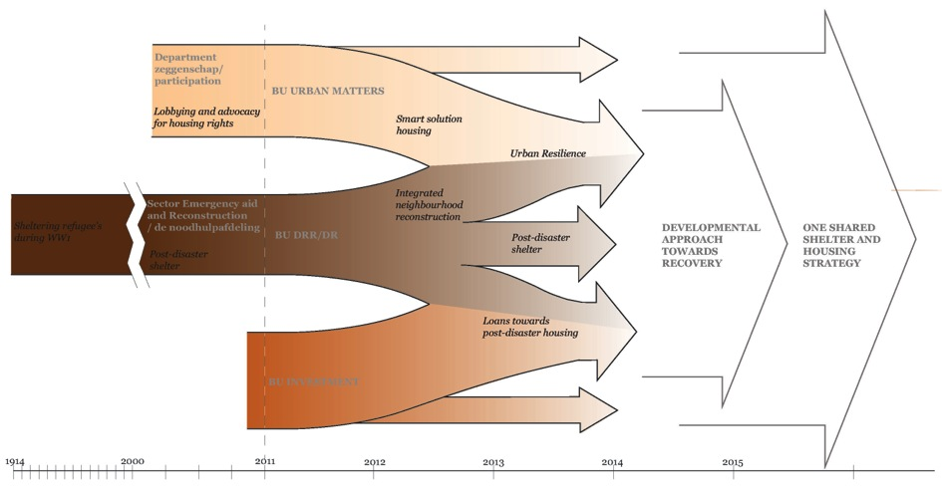
2. OUR TRACK-RECORD
100 YEARS OF PRACTICE
IN SHELTER HOUSING AND FINANCE
Shelter2Habitat April 2015
^{© Cordaid}

Slide 4
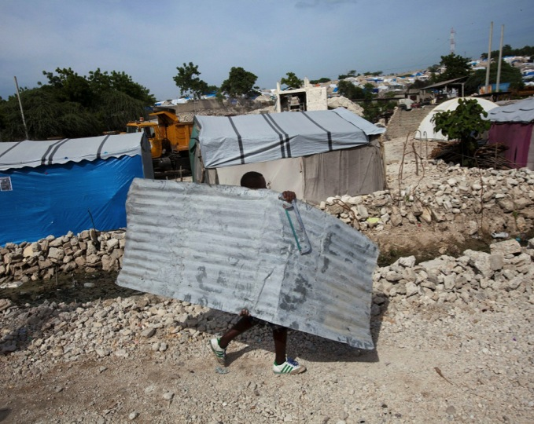
3. OUR PURPOSE
WHY THIS CHALLENGE
SHELTER2HABITAT
Growing number of urban communities at risk.
After disasters a large number of households (80 to 90%) do not receive shelter assistance.
Most shelter interventions are short-term relief
Shelter2Habitat April 2015
^{© Cordaid}

Slide 5
4. VALUES
WHAT DO WE BELIEF IN
“Shelter2Habitat”
Focus on “Habitat” which is > than shelter or housing
Respects DO NO HARM principles
Transparency and accountability
A fully scalable and replicable approach
Immediate focus on longer term programming
Shelter2Habitat April 2015
^{© Cordaid}

Slide 6
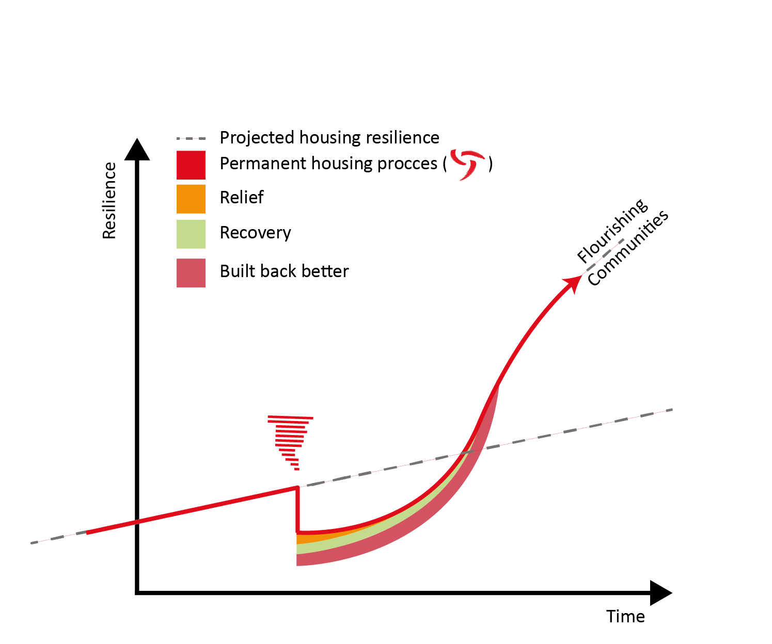
4. VALUES
FROM SHELTER 2 HABITAT
Shelter2Habitat April 2015
^{© Cordaid}

Slide 7
5. OUR APPROACH
HOW DO WE DO IT?
“Shelter2Habitat” approach
Community-driven / controlled processes
Coordinating with all stakeholders
Transitioning from grants to loans.
Integrated development matching the incremental housing process with successive affordable loans
Shelter2Habitat April 2015
^{© Cordaid}

Slide 8
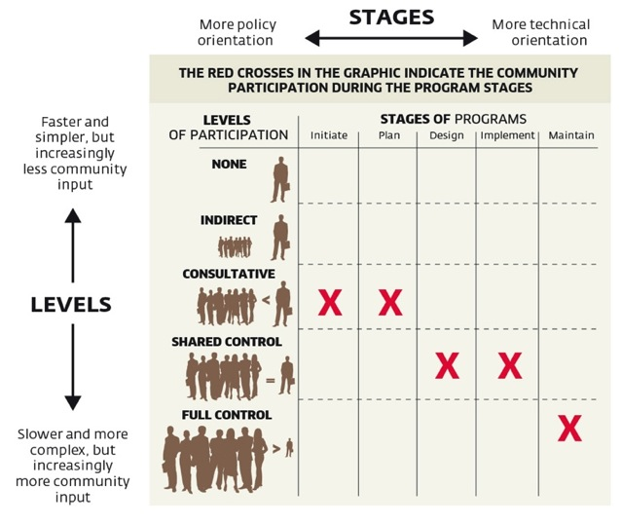
5. OUR APPROACH
COMMUNITY ‘CONTROLLED’
Source: Goethert & Hamdi (1997), Action Planning for Cities
Shelter2Habitat April 2015
^{© Cordaid}

Slide 9
5. OUR APPROACH
MULTI STAKEHOLDERS PROCESS
Involving all stakeholders
A changing Cordaid role during the process and phases
Coordinated approach with a wide(r) geographic focus
Shelter2Habitat December 2014
^{© Cordaid}

Slide 10
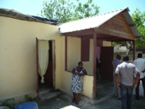
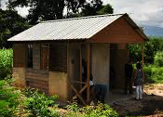
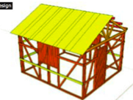
5. OUR APPROACH
INCREMENTAL DEVELOPMENT MATCHING HOUSING
Decent house: Expansion to core house based on own ambitions
Basic house: Core house (permanent)
Sanitation household level: Latrine, washing facilities, etc
Community Infrastructure: Improvements to ‘basic package infrastructure’ , amenities, etc
Minimum package – LIFE SAVING INFRASTRUCTURE: Immediate protection works (eg. Escape routes, collective shelter, land stabilisation, collective sanitation facilities) – LIFE SAVING HOUSING: phase 1 (eg. E/T- shelter on foundations to take expansion incl. sanitation, ODH/retrofitting)
Shelter2Habitat April 2015
^{© Cordaid}

Slide 11
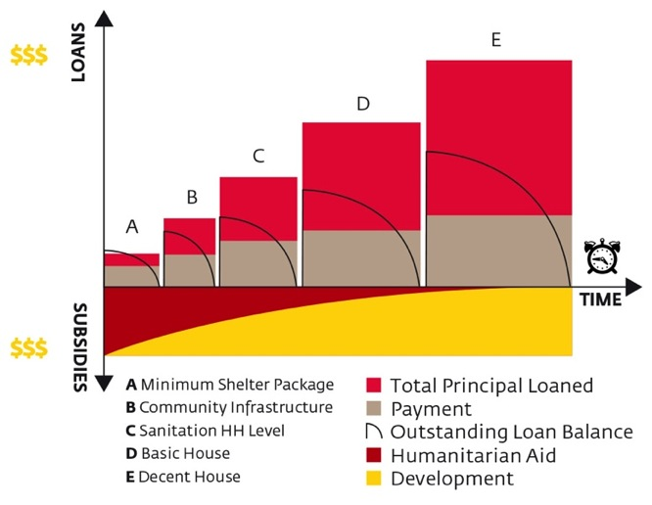
5. OUR APPROACH
FROM SUBSIDY TO MARKET LOANS
Shelter2Habitat April 2015
^{© Cordaid}

Slide 12
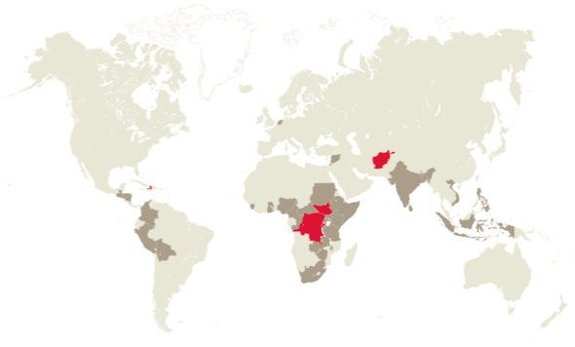


6. OUR AMBITION
HOW WE MAKE IT HAPPEN
TEAM MEMBERS
Cordaid
Urban presence
DRR presence
Inge Bouwmans
Expert Urban Development
inge.bouwmans@cordaid.nl
Inge Leuverink
Shelter Expert DRR-DR
Jan-Willem.Wegdam@cordaid.nl
CO-FINANCING AVAILABLE
TRACK RECORD
PARTNER NETWORK
Annual budget 2014 for Disaster Risk reduction & Response and Urban programs : 25 mio Euro
Secured in 2014 for start up of new Urban resilience program : 450.000 Euro
100
YEARS IN DISASTER MANAGEMENT
27 International NGO’s
49 National NGO’s
20 Regional NGO’s
International networks
Partners for resilience alliance
UN Habitat lead partner
Caritas internationalis network
25
YEARS IN URBAN DEVELOPMENT
Shelter2Habitat December 2014
^{© Cordaid}

Slide 13

HEALTHCARE
DISASTER RESILIENCE
ENTREPRENEURSHIP
WOMEN’S LEADERSHIP
CHILD & EDUCATION
EXTRACTIVES
FOOD SECURITY
SECURITY & JUSTICE
URBAN MATTERS
INVESTMENTS
CORDAID FACTS AND FIGURES
Eur 145.1M
SPENT FIGHTING ON POVERTY
316.000
PRIVATE DONORS IN NL
634
PARTNERS
36
COUNTRIES
SOURCE: ANNUAL REPORT 2012
INFORMATION
More information see www.cordaid.org/
You can also contact
CONTACT
Cordaid
P.O. Box 16440
2500 BK The Hague
The Netherlands
+31(0)70-3136300
www.cordaid.org

