Slide 1
Infrastructure – cross cutting or unifying?
Steven Crosskey
Infrastructure and Project Management Team
August 2016

Slide 2
UN Cluster System
Humanitarian & Emergency Relief Coordination – Information Management
- Airfields
- Harbours
- Roads
- Warehouses
- Warehouses
- Distribution centres
-Markets
- Shelters
- Water
- Sanitation
- Power
- Drainage
- Power
- Telecoms
- Roads
- Power
- Telecoms
- Water
- Sanitation
- Shelter
- Hospitals
- Schools
- Schools
- Power
- Roads
- Power
- Warehouses
- Shelter
- Telecoms
- Roads
- Shelter
- Power
- Water
- Sanitation
- Drainage
- Solid Waste
- Hospitals
- Health Clinics
- Power
LOGISTICS
NUTRITION
EMERGENCY SHELTER
CAMP MGMT & COORD
HEALTH
PROTECTION
FOOD SECURITY
EMERGECNY TELECOMS
EARLY RECOVERY
EDUCATION
SAN, WATER, HYGIENE
INFRASTRUCTURE

Slide 3
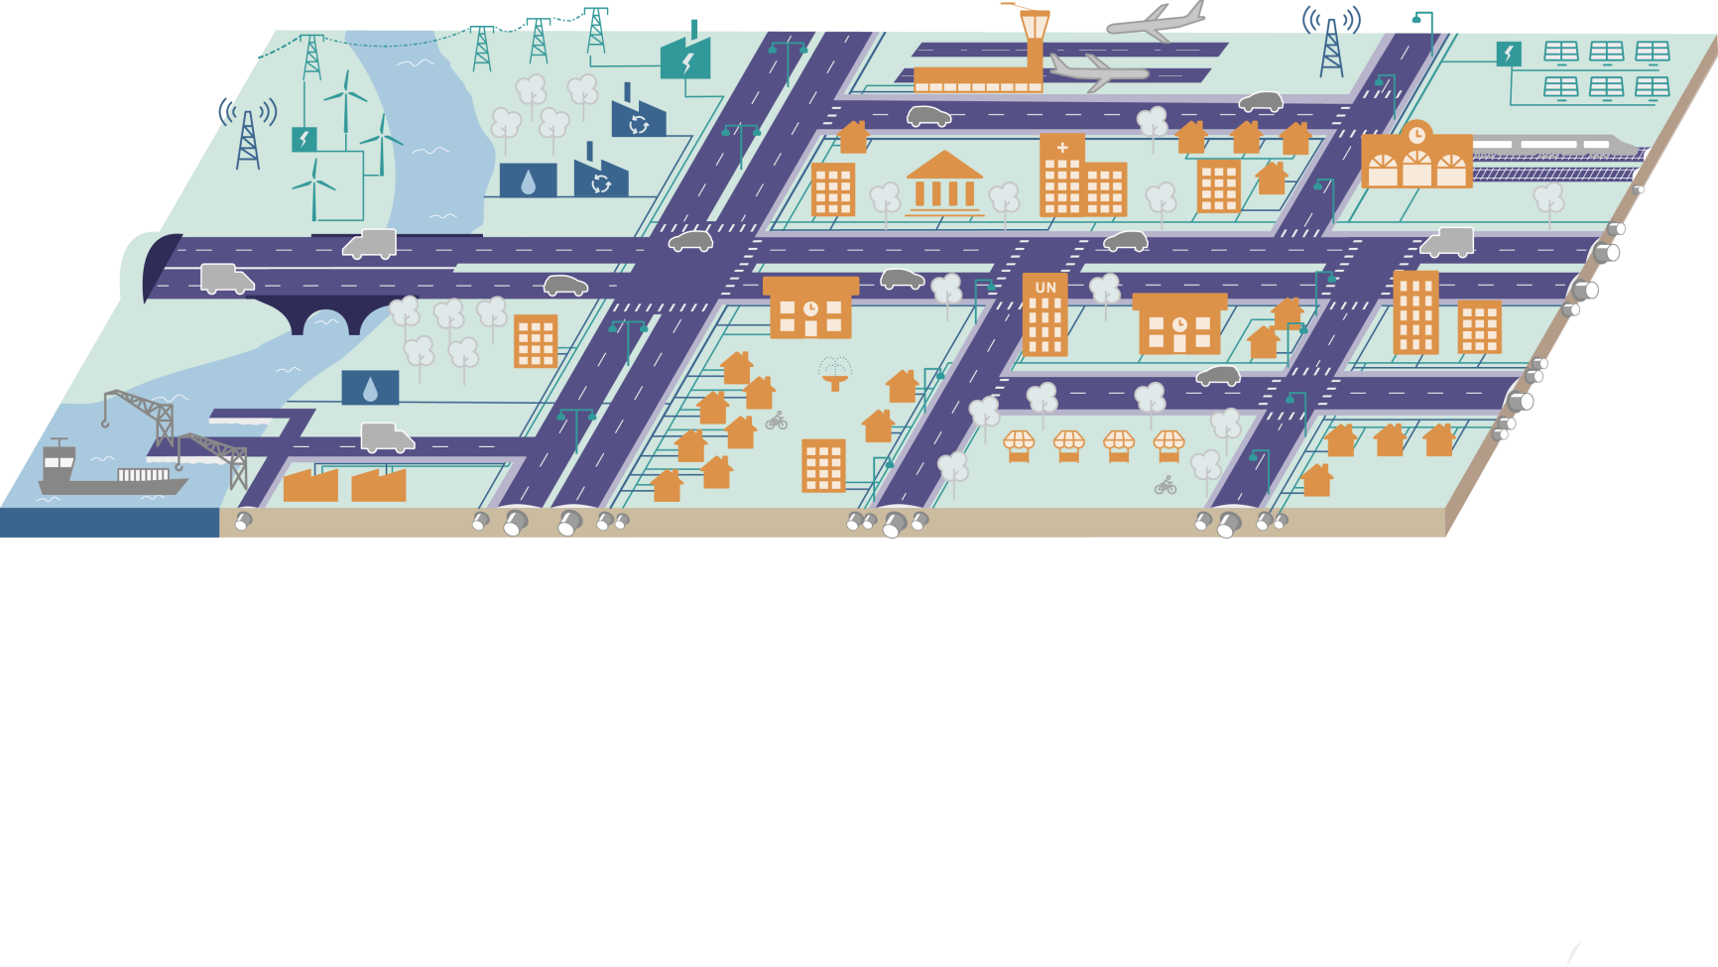
INFRASTRUCTURE
Systems: Infrastructure

Slide 4
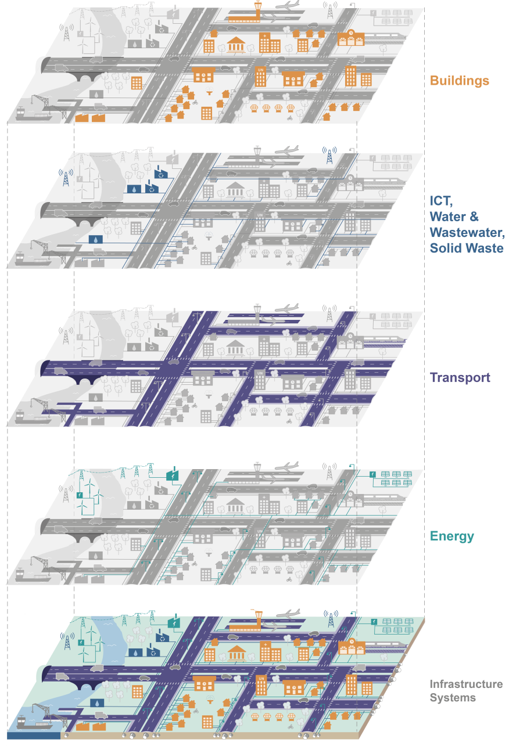
INFRASTRUCTURE
Infrastructure as interconnected systems
Understand Interconnected Nature.
Integrated Planning.
Get rid of Silos.
Prioritise Planning
Assure functionality.
Long life cycle – impacts on future
Cross sectoral coordination.

Slide 5
Development Continuity
Development
New Development Pathway Informed by Failure Analyses
Build Back Better
Continuation of the original Development Pathway
Loss of Development Gains
Development Pathway
The slope of the curve is a function of the ability to recover from shocks and stresses and adapt
= Resilience
The depth of the curve is a function of the ability to absorb and cope with shocks and stresses
Time
Development / Preparedness
Response
Recovery
Development / Preparedness

Slide 6
Infrastructure key points
Systems approach needed to ensure efficiency, assure functionality, making right early decisions for long term benefit.
Infrastructure cuts across clusters / sectors.
Encourages and needs coordination in planning and implementation
In infrastructure two important areas:
Preparedness (mitigation and adaptation)
+ Recovery (Build Back Better)
Better Development
Reduced response need

Slide 7

Questions
How to coordinate infrastructure activities across the current clusters, and through preparedness/ response/recovery and development?
How to improve delivery of appropriate infrastructure solutions? BBB
Intent to study infrastructure in Humanitarian settings – types, costs, needs and lessons.
Camp Planning Design and Construction Manual – example of cross cluster working.

Slide 8
THANK YOU
Any Questions / Follow up?
Please contact me - Steven Crosskey
StevenC@unops.org

