Slide 1
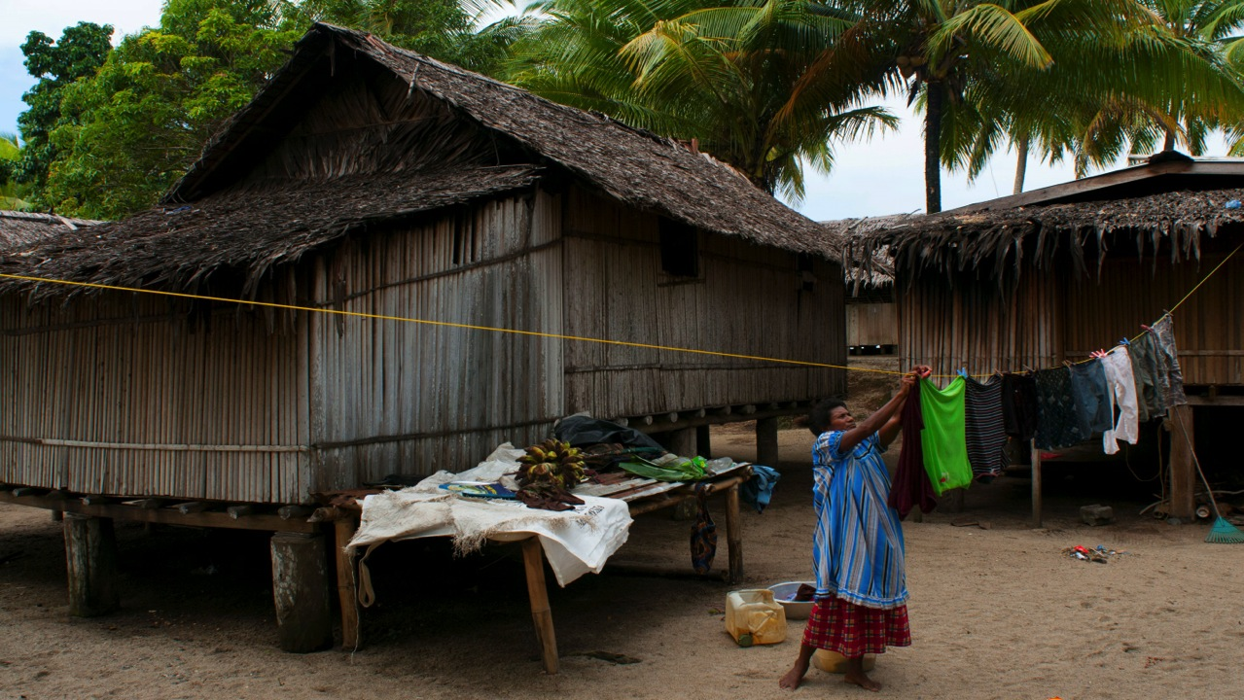
Health, Security, Privacy and Dignity:
Measuring Shelter Impact across Sectors

Slide 2
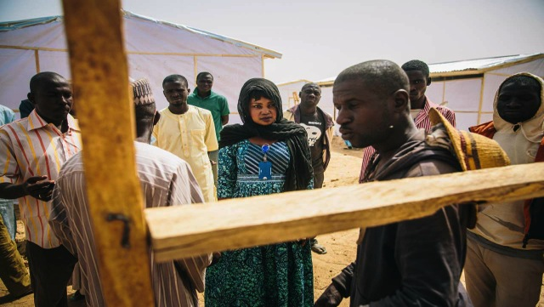
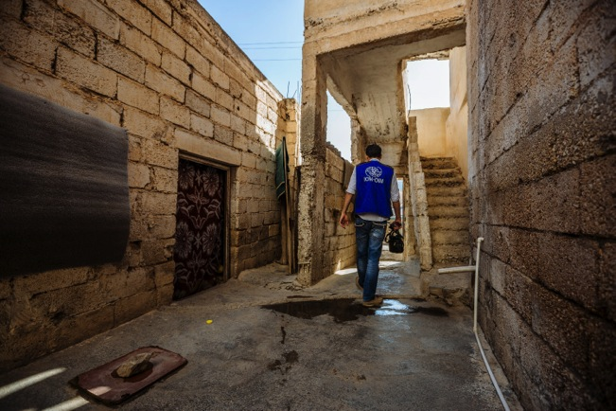
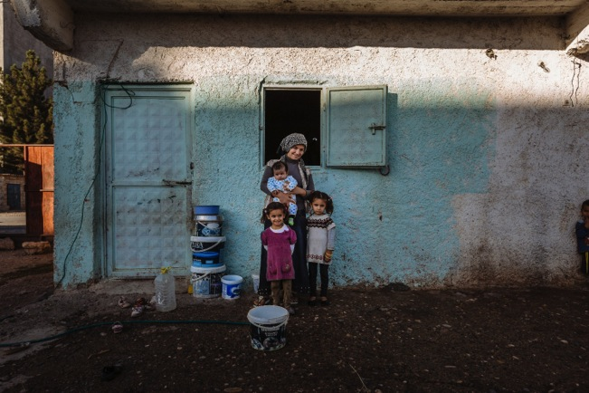
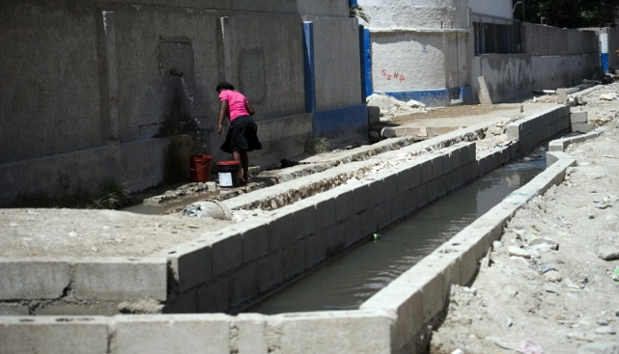

Slide 3
Consequences of GBV:
Physical health consequences | Psychological health consequences | Social & Economic consequences
Physical injury | Depression | Victim-blaming
HIV/AIDS | Fear | Stigmatisation
STIs | Self-blame | Rejection
Unwanted pregnancy | Anxiety | Isolation
Unsafe abortion | Mental illness | Decreased earning capacity/contribution
Fistula | Suicidal thoughts/actions | Increased poverty
Death |  | Risk of re-victimization

Slide 4
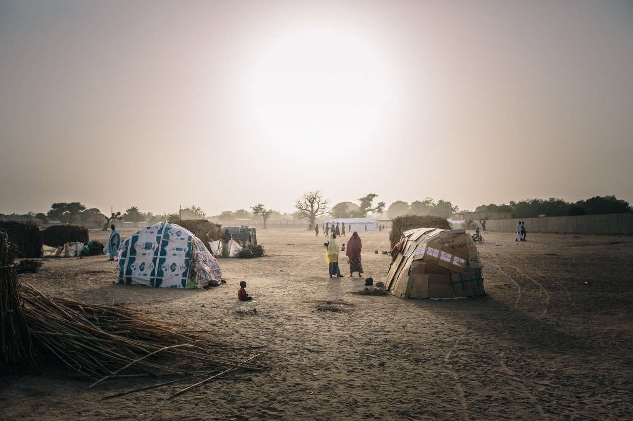
“Female-headed households who arrive and register once much of the camp is already established May be pushed toward the camp outskirts.”
“Street lighting provides security, especially near communal facilities used at night….”
“The location of facilities in central, accessible and well-lit areas with good visibility of the surrounding area can contribute to ensuring the safety of users.”
“Avoid high population density congestion in settlements and in accommodation.”
“Communal latrines are often used at night. Therefore some form of lighting may need to be provided.”

Slide 5
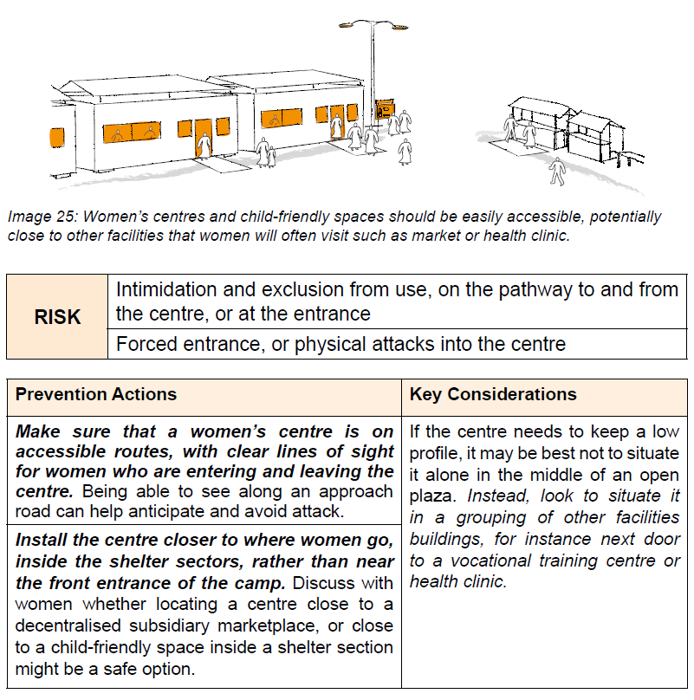
"People need to _move_ safely around. Can people going down the street see from
beginning to end?"

Slide 6
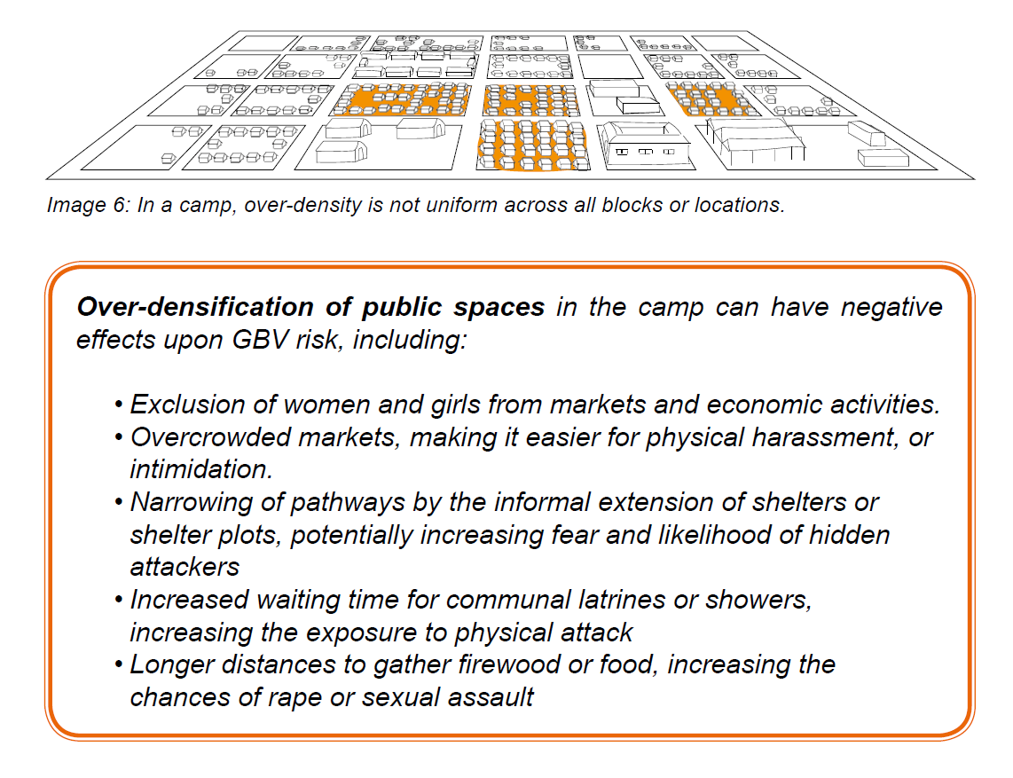
"In one camp, where there was a totally uniform design across the camp, it did not result in a totally uniform incidence of security problems."

Slide 7
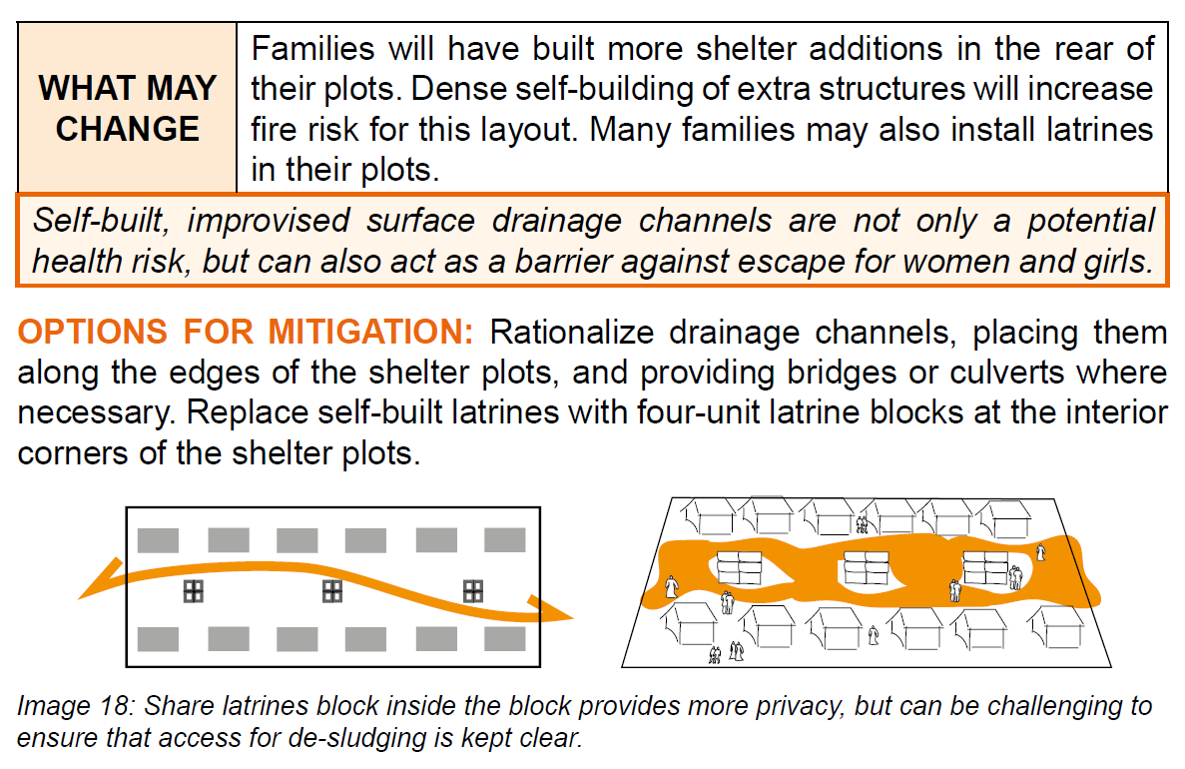
"We need to concentrate upon prevention, rather than just reporting afterwards."

Slide 8
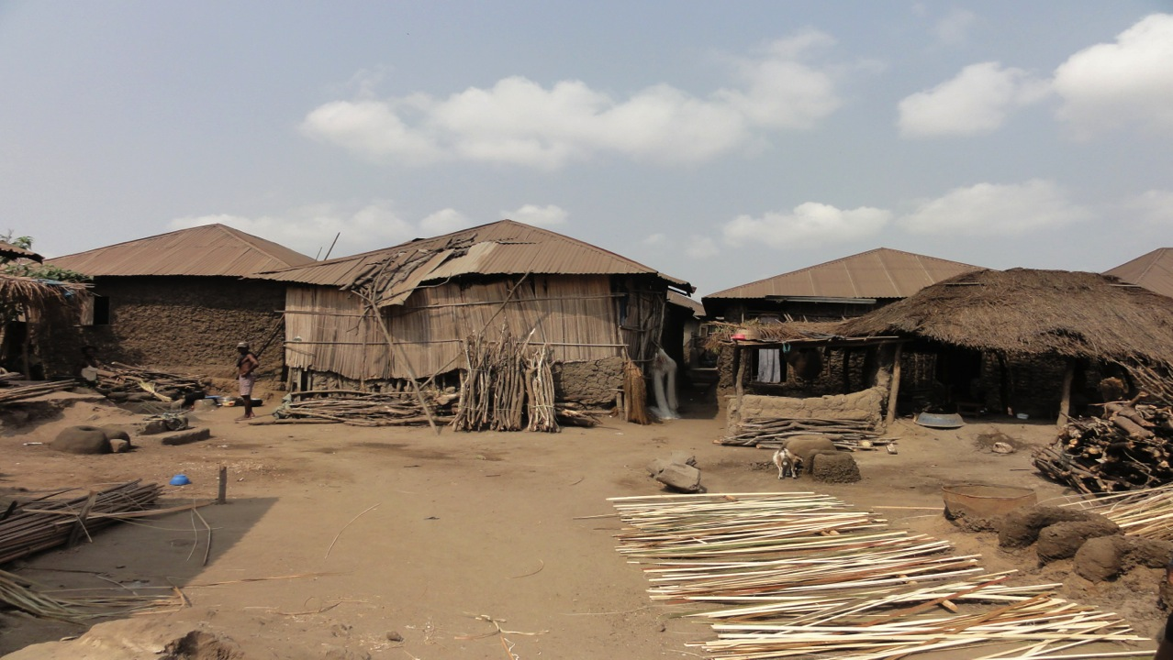
Number of households provided with an NFI kit meeting their basic needs
Number of communities consulted and the consultations held
Number of protracted IDPs with improved shelter through cash and vouchers
Number of displaced who received emergency shelter kits and NFIs
Percentage of target beneficiaries who indicate better protection from the environment and better living conditions after upgrade

Slide 9
"Consultation gives a rationale for decisions, and a documented history, to help mitigate any tensions caused by decisions taken."

Slide 10

Thank you

