Slide 1
Urban planning after crises: supporting local government
Victoria Maynard, David Garcia
Elizabeth Parker, Rahayu Joseph-Paulus
www.iied.org/urban-crises-learning-fund

Slide 2
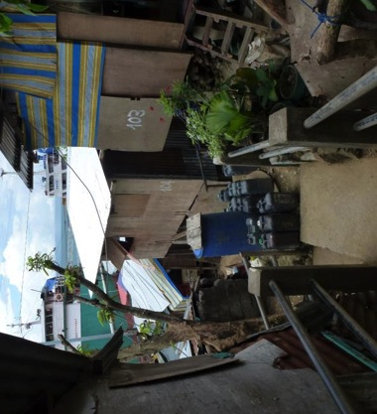
Area-based approaches
British Red Cross
Integrated Neighbourhood Approach
Port-au-Prince, Haiti
Catholic Relief Services
Urban Shelter and Settlement
Recovery Programme
Tacloban, The Philippines

Slide 3
Literature review
Potential negatives:
Islands of excellence
Tensions with other areas
Disconnect with wider plans
Distract from underlying problems
Focus responsibility at local level
“Link area-based approaches
to wider city or regional
plans and policies”
But how?

Slide 4
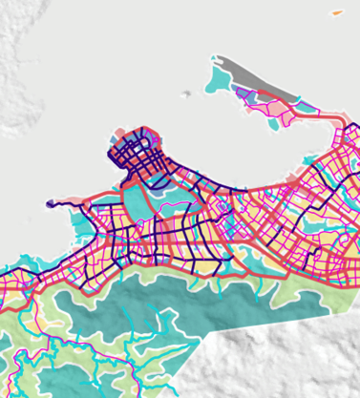
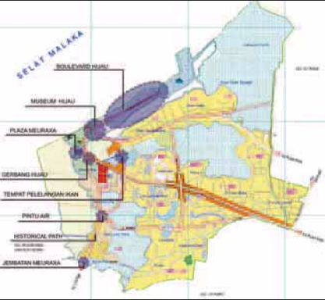
Support for urban planning
UN-Habitat
Meuraxa, Banda Aceh
Indonesia, 2005+
UN-Habitat
Tacloban, Ormoc, Guiuan
The Philippines, 2013-2016

Slide 5
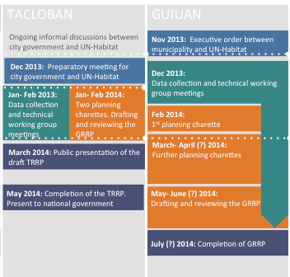
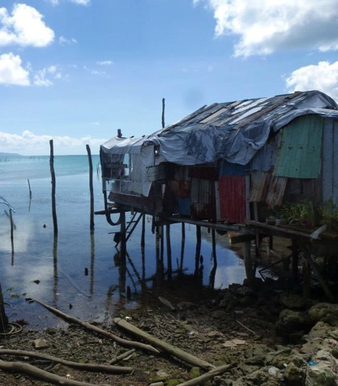
Investigating process and effects

Slide 6
Learning for other contexts…
What were the advantages and disadvantages of UN-Habitat’s approach?
What worked well and what was not as effective?
What factors helped or hindered UN-Habitat’s intervention?
strategy
programme
context

Slide 7
More information
The Philippines
Indonesia
www.iied.org/urban-crises-learning-fund
ALNAP Urban Response Community of Practice
victoria.c.maynard@gmail.com
david.garcia.ph@gmail.com
Urban planning after humanitarian crises: supporting local government to take the lead

