Slide 1
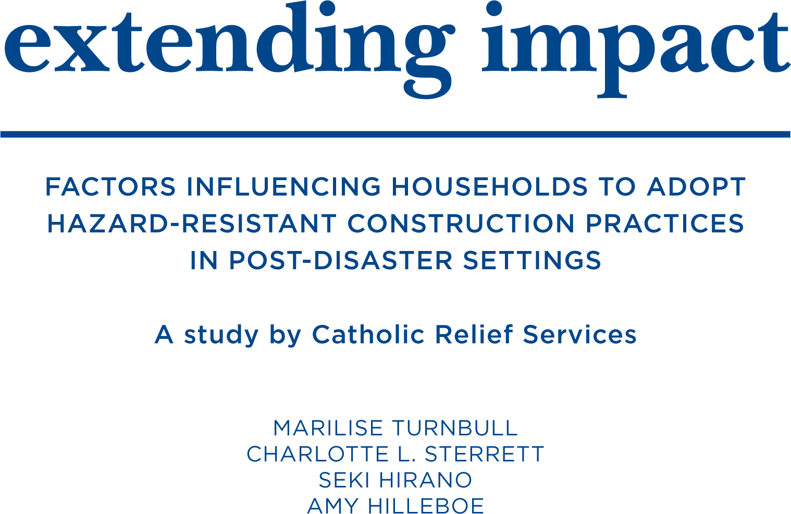
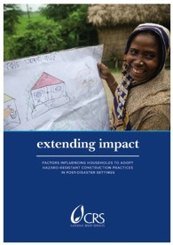
Extending Impact
Seki Hirano
Senior Technical Advisor
Shelter and Settlements

Slide 2
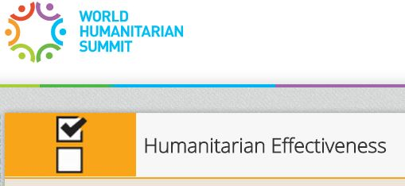
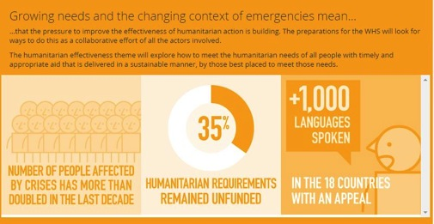
The challenge
One of the greatest challenges of post-disaster housing reconstruction is the sheer scale of destruction and the resources required for recovery efforts. In the past decade, over 25 million people have been made homeless by disasters, but only a fraction of them became beneficiaries of reconstruction programs
We wanted to find out what makes for a more effective, increase impact with the resources granted to us to assist as many families safe towards future disasters.
This study focuses on UNAIDED FAMILIES.

Slide 3
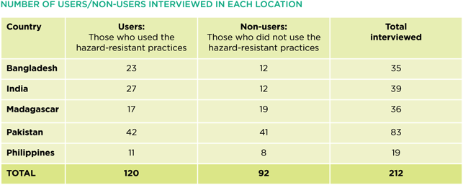
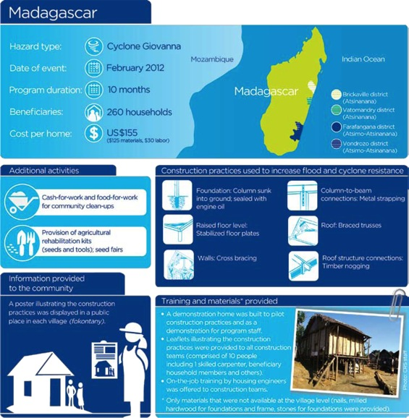
CRS used the Designing for Behavior Change methodology to conduct a study on head of households perceptions of using CRS‑recommended hazard‑resistant construction practices in five countries where CRS had implemented post‑disaster reconstruction projects in the last six years: Bangladesh, India, Pakistan, the Philippines and Madagascar.

Slide 4
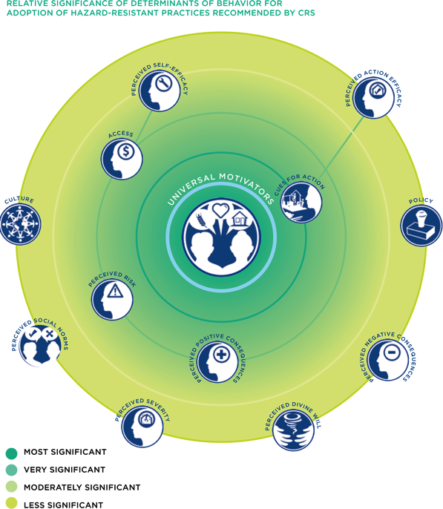
Conclusion and recommendations
Top five determinants
Cues for action proved the most significant determinant.
Access to materials and skilled labor
Perceived risk
Perceived positive consequences
Perceived self‑efficacy
Notes:
Cues for action proved the most significant determinant. Demonstration homes constructed to show the use of the hazard‑resistant practices were more effective than any other deliberate actions undertaken by CRS in influencing non‑beneficiaries’ choices during reconstruction. Observing the construction of CRS beneficiaries’ homes also prompted many non‑beneficiaries to adopt the practices. Thus, organizations such as CRS should maximize the ‘cue’ value of demonstration homes and beneficiaries’ homes by increasing direct contact with them and the skilled laborers working in them. Instead of seeing homes only as program outputs, organizations should use them as multipliers / leverage points for extending impact beyond direct program beneficiaries.
Access to materials and skilled labor was also shown to be a significant determinant. Alack of resources was a barrier for many families. Thus, organizations such as CRS should ensure that the hazard‑resistant practices they promote are easier to access, both financially and physically. This requires a substantial departure from the concept of providing a small proportion of disaster‑affected families with new homes while others, who may be similarly poor and vulnerable, do not receive any support to help them ‘build back safer’.
Perceived risk also proved to be a significant determinant. When people felt that their community would be affected by another cyclone or flood in the near future and recognized that the way their home was constructed made them more vulnerable, they took action to construct a safer home. Thus, organizations such as CRS need to ensure that people understand the components of risk, and that the construction practices they choose directly affect whether their home will withstand a hazard event. This requires a greater investment in information and education than is normally made in reconstruction programs, as well as including the promotion of safe housing (along with resilient livelihoods and community organization) in long‑term disaster risk reduction programs.
Perceived positive consequences was also a significant determinant. People who directly associated the construction practices with preventing damage to their home during hazard events and increasing their home’s overall stability and durability were more likely to adopt them. To scale up the adoption of hazard‑resistant construction practices, organizations such as CRS should ensure that people understand their advantages in severe climatic conditions and the everyday and long‑term benefits of using them. This requires investing more time in understanding which aspects of their home are most important to each target group and creating a communications strategy that relates the recommended practices to them.
Perceived self‑efficacy was shown to be a moderately significant determinant, although its relationship with other determinants made it difficult to ascertain its relative importance. People were prevented from using the practices when they felt they lacked the necessary skills and knowledge and were unable to pay a carpenter or mason to use them. Thus, organizations such as CRS should make program design choices based on knowledge of the relevant skill sets of the target communities, the extent to which skills need to increase for people to feel confident carrying out the practices, and the capacity of different sectors of the target communities to pay for skilled labor.

Slide 5
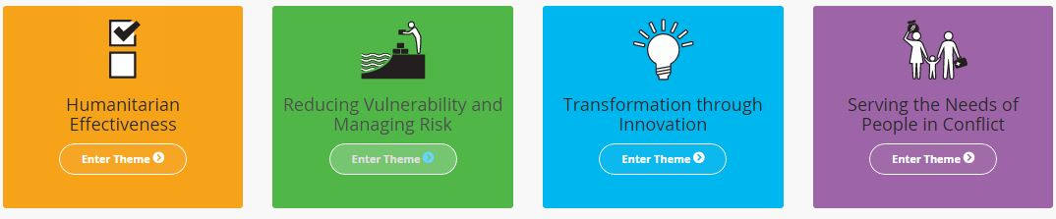
Interested to join us to promoting this way of working forward?
Could this way of targeting humanitarian assistance extend the impact we could have?
Opportunity;
Formulate a World humanitarian summit paper.
Join us in implementing some of the recommendations from the study?
http://www.crsprogramquality.org/2015/extending-impact
Contact; Seki.hirano@crs.org

