Slide 1
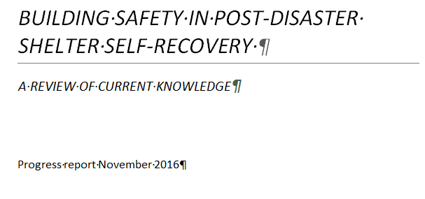

Slide 2


Slide 3
AIMS
Provide insights into the development of the use of the term self-recovery in post disaster shelter response, and to clarify its current use and meaning

Slide 4
Provide insights into the development of the use of the term self-recovery in post disaster shelter response, and to clarify its current use and meaning
Provide an overview of the range of interventions and strategies that have been employed to support self-recovery

Slide 5
Provide insights into the development of the use of the term self-recovery in post disaster shelter response, and to clarify its current use and meaning
Provide an overview of the range of interventions and strategies that have been employed to support self-recovery
Investigate current understanding of safety in self-recovery

Slide 6
Provide insights into the development of the use of the term self-recovery in post disaster shelter response, and to clarify its current use and meaning
Provide an overview of the range of interventions and strategies that have been employed to support self-recovery
Investigate current understanding of safety in self-recovery
Examine what factors promote greater safety in self-recovery, and what processes increase the risk of unsafe reconstruction

Slide 7
Academic papers that address safety more often report on assisted self-recovery processes, rather than self-recovery that affected individuals and communities engage in without any outside support.
FINDINGS

Slide 8
Academic papers that address safety more often report on assisted self-recovery processes, rather than self-recovery that affected individuals and communities engage in without any outside support.
They are also more likely to report processes and interventions that aim to improve safety in shelter self-recovery.

Slide 9
Academic papers that address safety more often report on assisted self-recovery processes, rather than self-recovery that affected individuals and communities engage in without any outside support.
They are also more likely to report processes and interventions that aim to improve safety in shelter self-recovery.
Articles that focus on unassisted self-recovery discuss circumstances in which safety is either not considered or has not been addressed effectively in shelter reconstruction, as well as case studies that describe improved safety in unassisted self-recovery.

Slide 10
Academic papers that address safety more often report on assisted self-recovery processes, rather than self-recovery that affected individuals and communities engage in without any outside support.
They are also more likely to report processes and interventions that aim to improve safety in shelter self-recovery.
Articles that focus on unassisted self-recovery discuss circumstances in which safety is either not considered or has not been addressed effectively in shelter reconstruction, as well as case studies that describe improved safety in unassisted self-recovery.
Only one of the studies reviewed so far provides evidence of follow-up a significant amount of time after the post-disaster self-recovery process occurred. Without this, it is difficult to effectively assess the safety of repair or reconstruction.

Slide 11
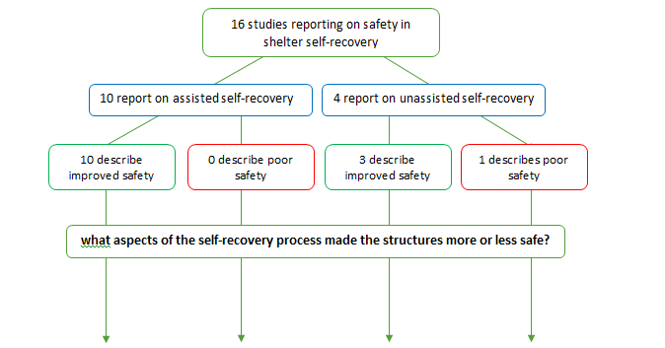

Slide 12
ASSISTED SELF RECOVERY : safer
On site demonstration of construction techniques and materials
Design advice and technical guidelines for self-builders
Staged payments based on assessed building quality
Training programmes demonstrating how workmanship or design features can result in safer buildings
Flexibility of authorities to include seismic resistant principles rather than strict adherence to approved designs
Training local craftsmen
Expert evaluation post-disaster of building elements that had contributed to hazard vulnerability or building safety
Ensuring economically viable, sustainable supplies of building materials, technologies and skills
Further disaster demonstrating hazard resistance of the improved building method

Slide 13
ASSISTED SELF RECOVERY : less safe
0

Slide 14
UNASSISTED SELF RECOVERY : safer
Community group taking responsibility for choosing hazard resistance materials in reconstruction
More unsafe elements in building design than assisted self-builders, but also more specifically designed safe spaces in houses for use in case of catastrophic events

Slide 15
UNASSISTED SELF RECOVERY : less safe
Mistrust of local engineers and assessors
economic constraints and limited awareness of appropriate safety features
Lack of skill and knowledge amongst local workers about resilient construction
Poor consultation during high-cost rebuilding programme led to self-building extensions on too-small houses, incorporating weaknesses of traditional building
Poor communication of risks of traditional building methods during repair programme

