Slide 1
Protection Mainstreaming and Shelter
Cat Cowley
Protection Mainstreaming Coordinator

Slide 3
People living with disabilities
People with chronic diseases
Do No Harm
Child Protection
Sphere
DRR
Prevention of sexual abuse and exploitation
Code of Conduct training
Core Humanitarian Standards
Hyogo Framework
Risk and culture
HIV and AIDS
Environment
Governance
Older persons
HAP
Accountability
Humanitarian Principles
Mental Health and Psychosocial support
Conflict Sensitive Approach
Gender
Human rights

Slide 4
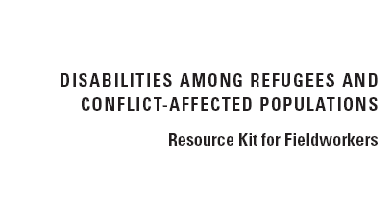
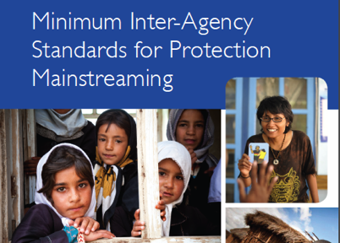
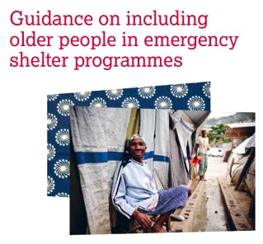

Slide 6
Protection Mainstreaming
“The process of incorporating protection principles and promoting meaningful access, safety and dignity in humanitarian aid”*
* Global Protection Cluster
Notes:
Global Protection Cluster (GPC)
The GPC has developed a definition of protection mainstreaming, to differentiate it from general protection activities
Protection mainstreaming is also sometimes referred to as “Safe Programming”
Protection mainstreaming focuses not on WHAT we do (the product), but rather on HOW we do it (the process)
ALL organizations have a responsibility to mainstream protection
The 3 key words are safety, dignity and access

Slide 7
Stand alone
Protection Integration
Core components of Protection Mainstreaming
Targeting Priority Groups
Feedback Mechanisms
Community Engagement
Information Sharing
Mapping / Referral
Coordination / Advocacy
Analysis
Staff Conduct
Guiding Principles
Do No Harm (safety & dignity)
Equality
(access)
Accountability to beneficiaries
Participation and Empowerment

Slide 8
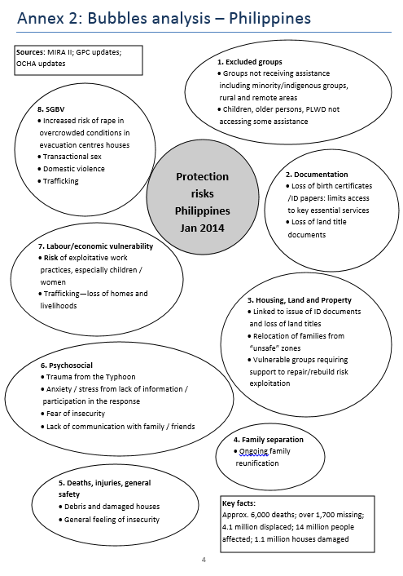

Slide 9
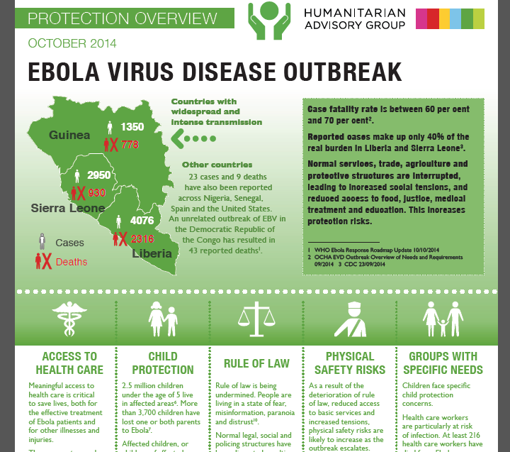

Slide 10
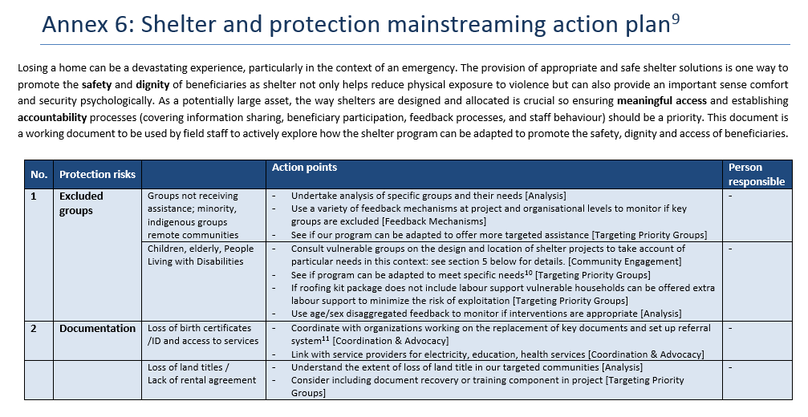

Slide 11
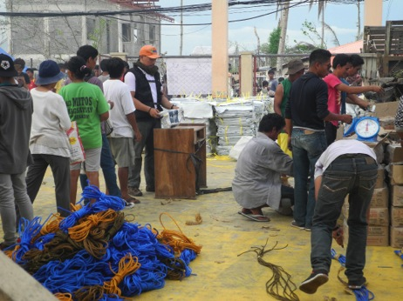
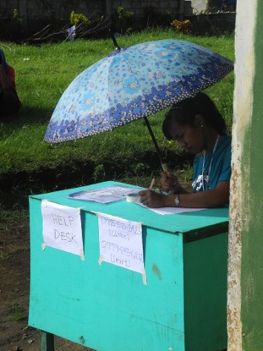
Philippines

Slide 12
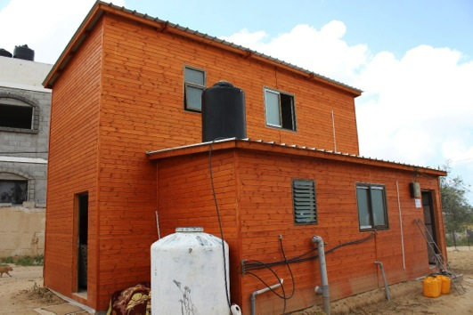
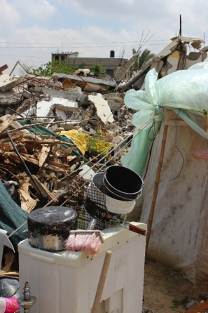
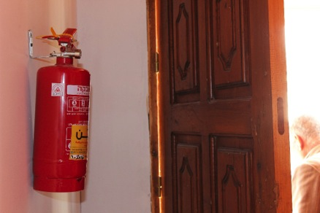
Gaza

Slide 14
SAD-SAD
Safety
Sex
Access
Age
Dignity
Disability
Notes:
The diagram above is one way of looking at how protection mainstreaming interacts with various factors including sex, age and disability (the focus for the time being will be on disability rather than on the broader category of diversity). This can help staff think through how each factor interacts with and affects the 3 key areas of protection mainstreaming which are safety, dignity and access.
For example:
How does the sex of a person affect their safety in a shelter project?
How does the sex of a person affect their access to a voucher distribution (for example are their cultural barriers preventing them from going to a site unaccompanied)?
What is considered dignified/appropriate for an older person compared to a younger person in regards to a nutrition programme?
How does the physical mobility of a person affect their safety in a WASH project?
What would enhance the dignity of a person with visual impairments in a cash distribution?

Slide 15
Q&A
What challenges still exist?
What would be useful for the shelter sector and how do we move that forward?

