Slide 1

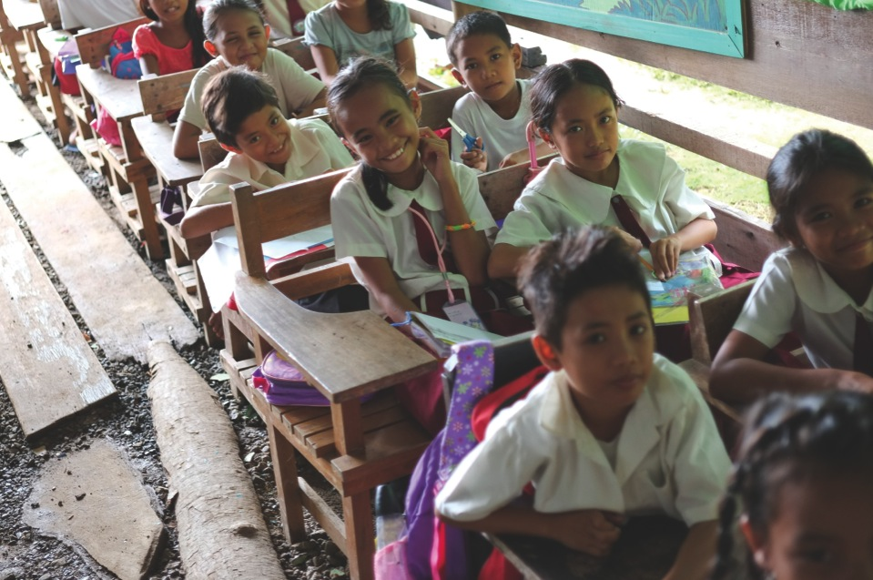




Towards Safer School Construction
A community-based approach
Hayley Gryc – Arup International Development
Notes:
Understand this is not about shelter – but many organisations implementing shelter also construct schools
Wanted to bring to your attention this guideline that has been developed to show how community based safe school construction can do more than just provide
communities with learning facilities. It can also:
Raise awareness about hazards within communities
Build local capacity for safe construction practices
Strengthen a culture of safety within and around the school
Increase a sense of community ownership of the school
Ensure community values are incorporated into school designs
FOCUS of this guide will be on the processes of community based school construction. It should supplement technical guidance on appropriate construction materials and techniques,

Slide 2
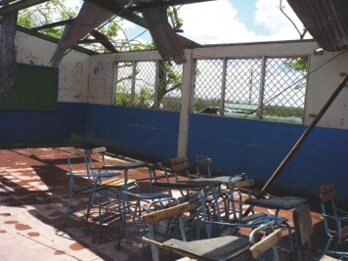
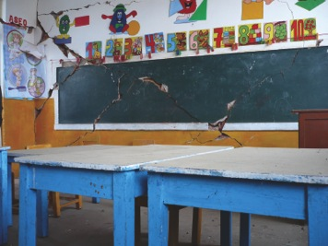
Photographer: Claudio Osorio, INEE
Photographer: Claudio Osorio, INEE
Purpose of the Guide
Photographer: Claudio Osorio, INEE
Notes:
Why developing this book –
School safety is now a global concern -
Each year, disasters caused by natural hazards around the world have a devastating effect on children’s education often putting them in danger in the very institutions that are meant to protect and nurture them - schools.
The 2008 Sichuan earthquake crushed 10,000 students to death in their classrooms.
In 2013 Typhon Yolanda partially or completely damaged 2500 learning facilities and 800 day care centres.
The 2007 Cyclone Sidr affected over 145,000 children; reconstruction was estimated at US$81 million.
The list goes on ……
Every child has the right to safety and survival and every child has the right to access to education
Most of the world’s schools are commissioned by communities, local governments, or national governments.
Until the 1980s, school construction in most developing countries was centralized at the level of the ministry of education or the ministry of public works.
Over time, however, it became apparent that the centralized approach often resulted in inadequate classroom allocation, weak monitoring capacity, and low quality of construction. In order to address the central government’s lack of capacity and to empower local communities, education ministries in the 1990s started to delegate the management and execution of school construction to contract management agencies (CMAs), social funds (SFs), or NGOs. Finally, a third approach emerged: decentralizing school construction to local governments and communities to bring the decision making process closer to the beneficiaries.
Very little sector guidance for small scale community-based school building projects with a specific focus on disaster resilience and safety (with the notable exception of the growing body of work on post-disaster reconstruction).
This work is intended to be a direct contribution to the work plan of the ‘Global Alliance for Disaster Risk Reduction and Resilience in the Education Sector’ Pillar 1 working group of the Comprehensive School Safety Framework which relates to Safe Learning Facilities.
The World Bank’s Global Facility for Disaster Reduction and Recovery (GFDRR), UN-Habitat, UNESCO, ARUP, IFRC, the IASC Shelter Cluster and many more have developed and published a significant number of key documents aimed and guiding decision making in the design and implementation of construction projects. This work aims to complement these initiatives by addressing the current gaps in the availably of information targeted at the community level which both raises awareness and understanding of the need for safety to be integral to the building process and outlines the issues and processes which are fundamental to ensure that community-based school construction projects are done in a way which meets internationally recognised standards of safety.

Slide 3

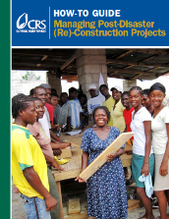
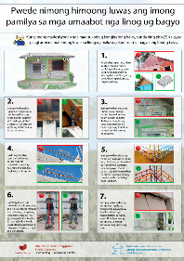
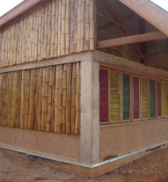
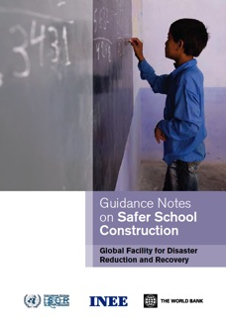
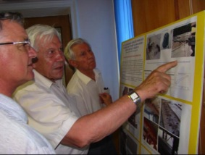
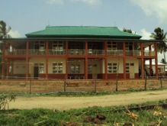
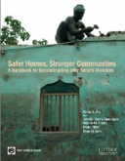
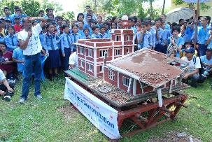
Photographer: Arup
How was it developed
Notes:
How was it developed:
Developed through a consultative process, guided by a steering group comprised of representatives from the Save the Children, GFDRR, UNESCO, Arup, and Risk RED.
Literature review
The steering group has identified leading experts in community-based school construction from around the world
These individuals were invited to serve as reference group members.
Reference group members were interviewed on good and poor practice in the field; many suggested other experts to be added to the
reference group. - case studies
We then held a 2-day technical consultation in February 2015 – in Bangkok where they clarified key principles and activities necessary
for community-based safe school construction.

Slide 4
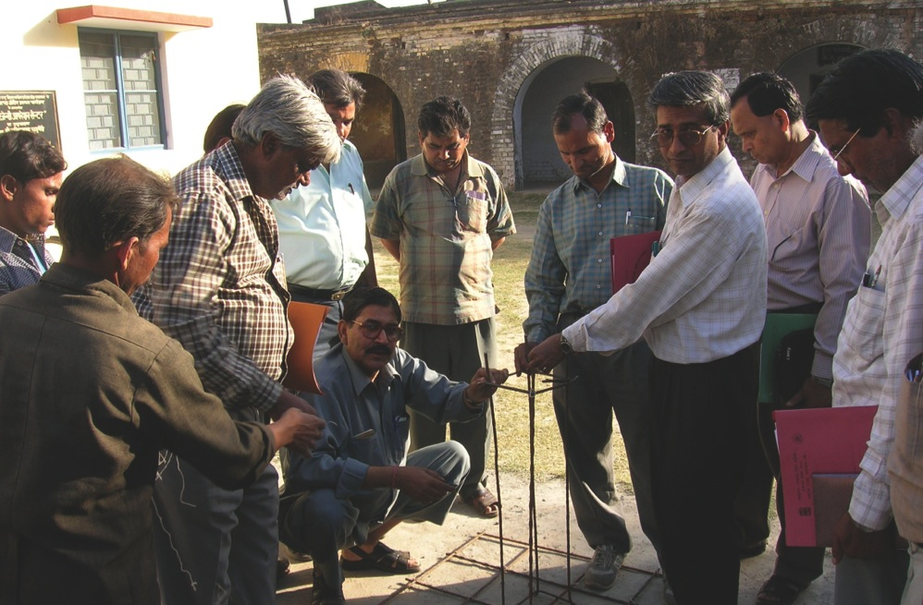
Who is it for?
Photographer: Sanjaya Bhatia, UNISDR
Notes:
Who is it for
intended for decision makers and program advisors in implementing agencies involved in, or intending to begin, school construction in hazard-prone areas.
It will be primarily intended for development actors – the development and humanitarian organizations building and repairing learning facilities – as well as government bodies seeking to introduce or oversee community-based school construction programs. The guide also will provide insight for
community disaster risk reduction and disaster management practitioners within the education sector.

Slide 5
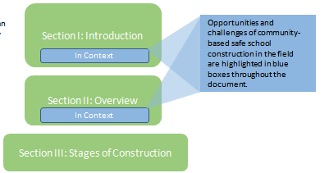
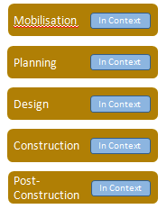
How to use the Guide
Notes:
What will it include
The document is divided into three sections:
an introduction,
an overview of a community-based construction process,
and a detailed description of stages of construction — mobilisation, planning, design, construction, and post-construction.
For each stage, the document describes key activities and considerations, as well as opportunities and challenges central to a community-based approach highlighted and case studies throughout the document.
While reading the document from start to finish is recommended, each section and stage of construction can be read independently.
guide specifically addresses the school building’s capacity to withstand natural hazards: floods, earthquakes, landslides, cyclones, and high winds.
Even though school safety in conflict zones or amongst threats of terrorism will not be covered in depth, some vignettes will provide guidance for these situations.

Slide 6
Published - May 2015 as a “Consultative Edition”
Over the next year collecting feedback from development actors, government bodies, and communities using the guidance
If this is of interest or you have any further queries please contact me;
  hayley.gryc@arup.com
Next Steps
Notes:
Next steps ;
Published - May 2015 as a “Consultative Edition”
Over the next year collecting feedback from development actors, government bodies, and communities using the guidance –
Asking for those of you involved in community based school construction programmes to test the guide and provide feedback – or contribute further case studies
Looking for this to be tested on different type of projects – scale and complexity and locations by a variety of different types of organisations in both the development and humanitarian context
Feedback on each of the sections – what are the most useful – don’t have to use the whole guide – could just review /test a particular section
OPPORTUNITY FOR YOU TO INFLUENCE
At the end of the day we don’t want people just to read it – we would like people to use it ……
Anyone contributing to this will be officially accredited …..
Future editions - dependent on feedback
Languages
Format – on-line / video

Slide 7
Thank you - Any questions?
Hayley Gryc
Associate
Arup International Development
Hayley.gryc@arup.com
Notes:
Next steps ;
Published - May 2015 as a “Consultative Edition”
Over the next year collecting feedback from development actors, government bodies, and communities using the guidance –
Asking for those of you involved in community based school construction programmes to test the guide and provide feedback – or contribute further case studies
Looking for this to be tested on different type of projects – scale and complexity and locations by a variety of different types of organisations in both the development and humanitarian context
Feedback on each of the sections – what are the most useful – don’t have to use the whole guide – could just review /test a particular section
If you would like to start using it now we can provide you with the text ….
OPPORTUNITY FOR YOU TO INFLUENCE
At the end of the day we don’t want people just to read it – we would like people to use it ……
Anyone contributing to this will be officially accredited …..
Future editions - dependent on feedback
Languages
Format – on-line / video

