Slide 1
Global Shelter Cluster
UK Shelter Forum
11 Nov 2016

Slide 2
Achievements 2015 & 2016
Notes:
Documents available here: http://www.sheltercluster.org/global

Slide 3
26 Shelter Clusters or cluster-like
Ukraine
UNHCR
Afghanistan
UNHCR/IOM
Palestine
NRC/ACTED
Syria
UNHCR
Nepal
IFRC
Chad
UNHCR/IOM
Sudan
UNHCR
Mali
UNHCR/IOM
Iraq
UNHCR
Bangladesh
IFRC/UNDP
South Sudan
IOM/World Vision
Yemen
UNHCR
Philippines
IFRC - IOM
El Salvador
HfH/IFRC
Ethiopia
IOM
Myanmar
UNHCR
Nigeria
NEMA/IOM/UNHCR
Pacific Region
IFRC
Ecuador
IFRC
CAR
UNHCR/ACTED
Somalia
UNHCR
DRC
UNICEF/CRS
Kenya
IOM / KRCS
Fiji
IFRC
Mozambique
IFRC/UNHABITAT
Malawi
IFRC
Conflict
Natural disasters
Both

Slide 4
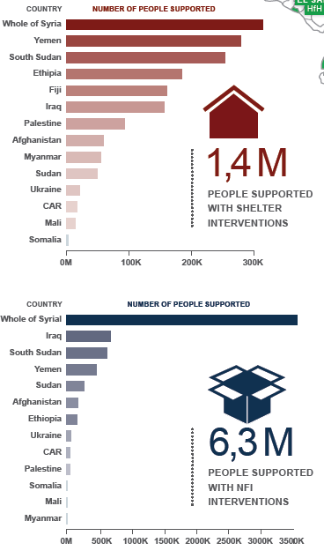
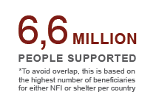
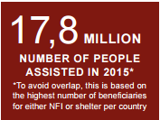

Slide 5
GSC Structure
SAG
DCG
Global Cluster
TWiGs
CoPs
Support
Team
Notes:
The Global Shelter Cluster is structured in different bodies in a similar way as country-level clusters are structured:
The Strategic Advisory Group (SAG) is a permanent body that works to advance the cluster’s strategic direction.
Current SAG members are: ACTED, CARE Int’l, Habitat for Humanity, InterAction, IOM, NRC, Save the Children Int’l, UNHABITAT, World Vision Int’l, IFRC, UNHCR
The Donor Consultation Group (DCG) is a consultative body made of self-selected donors that meets with the SAG once every three months. It is .
Current DCG members are: DFID, ECHO and USAID. Additional donors can be invited.
The Working Groups (WG) are created to address a certain gap and they disappear once that the gap is addressed:
WGs in 2016: Cash WG, Shelter Projects WG, Building Practices WG, Shelter and GBV WG
The Communities of Practice gather people that are interested in certain areas of work such as coordination, information management, environment.
The Support Team is the Secretariat of the GSC and it is responsible for the day-to-day running of the cluster. We will talk a bit more about it later.

Slide 6
Strategic Advisory Group (SAG)
ACTED
CARE International
CRS
Habitat for Humanity
IFRC
InterAction
IOM
NRC
Save the Children
UNHABITAT
UNHCR
World Vision International

Slide 7
GSC support team
Global Cluster Coordinators
Deputy Coordinators
Information Management
Ela Serardoglu
Natural Disasters IFRC
Brett Moore
Conflict UNHCR
Miguel Urquia
Conflict UNHCR
Pablo Medina
Natural Disasters IFRC
Bo Hurkmans
IMO UNHCR
Neil Bauman
GFP IFRC/CanRC
Global Focal Points for Coordination
Senior Roving Coordinators
Technical Coordinators
Communication & Advocacy
Graham Eastmond
UNHCR
Wardell Eastwood
UNHCR
Cecilia Braedt
IFRC/Lux RC
Vacant
NRC
Shirin Narymbaeva
Website support IFRC
Davide Nicolini
GFP UNHCR/SDC
Gregg McDonald
GFP UNHCR
Assessment M&E
Roving Focal Points
Grant Management
Joseph Ashmore
GFP IOM
Tom Bamforth
GFP IFRC
David Dalgado
IFRC
Vincent Annoni REACH/Impact Initiatives
Anna Pont
Americas
UN-HABITAT
Petya Boevska
ECHO grant manager UNHCR
Notes:
More on what this team does can be found here:
http://sheltercluster.org/what_we_do
http://www.sheltercluster.org/global_support_team_activities

Slide 8
Global Surge Capacity
New roles introduced in 2016
Senior Roving Cluster Coordinators: 2
Technical Coordinators: 2
Notes:
Each of the GFPs introduces him/herself and where has been

Slide 9
Communities of Practice & Helpdesk
Coordination
Information Management
Technical
Environment
Gender and Diversity
Recovery
Helpdesk@sheltercluster.org

Slide 10
Working Groups
Cash and Shelter
NFIs and meeting household needs
Construction Standards
GBV and Shelter
Shelter Projects 2015-2016
State of the Humanitarian Shelter

Slide 11
Cash and shelter
Position paper
Literature review
Cash and Shelter IM implications
Guidance

Slide 12
Outputs of the GBV WG and Site Planning

Slide 13
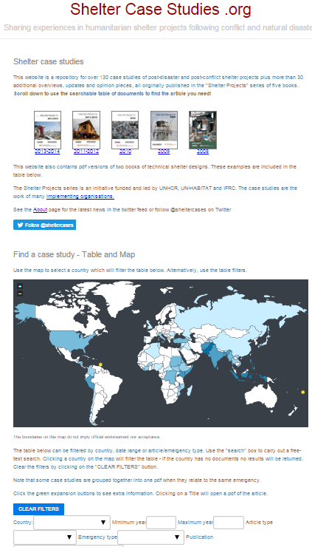
ShelterCaseStudies.org

Slide 14
GSC meeting
5-6 October 2016 in Geneva
122 participants
From 36 different shelter partners
Key challenges identified:
More predictable funding for shelter ops
Harmonized data collection
Increased coordination capacity at sub-national level

Slide 15
Thank you!
More info:
www.sheltercluster.org
Twitter: @sheltercluster
Supported by:

