Slide 1
Hardware, Software to Fluff-ware
UK shelter forum Nov 2016, Holistic programming
seki.hirano@crs.org
Global Senior Technical Advisor Shelter and Settlement
Notes:
Hardware, software to fluff-ware;
The shelter and settlement sector is fantastic at managing the hardware, and getting better at the software; community mobilization and knowledge transfer. How about fluff-ware?
Fluff ware; is how we deal with sentiments and emotions of an individual, community, a group or a nation.
When we say we want to increase work with existing systems, to seek solutions for crisis affected displaced population, the drive towards “out of camp” solutions come to mind.
This mean we depend upon local communities, neighborhoods and systems. The capacity for a host society to absorb additional populations of course depends upon availability of space, finance and materials. However, and moreover, I would argue it initially lies within the realms of fluff; the host’s generosity, empathy and the hospitality to welcome and share their city, homes, neighborhoods. If those affected by crisis are not welcomed, when distrust or resentment is prevalent, then the opportunity for humanitarians to tap into existing systems starts to close in on us, in effect the doors starts to close and we might return to the closed camps.
In this session I would like to introduce fluff-ware as part of a holistic shelter and settlement program.

Slide 2
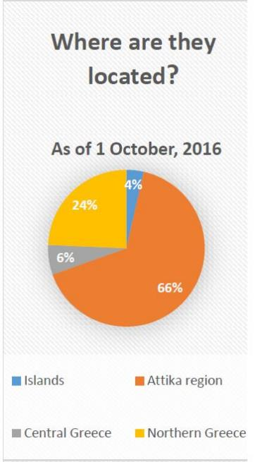
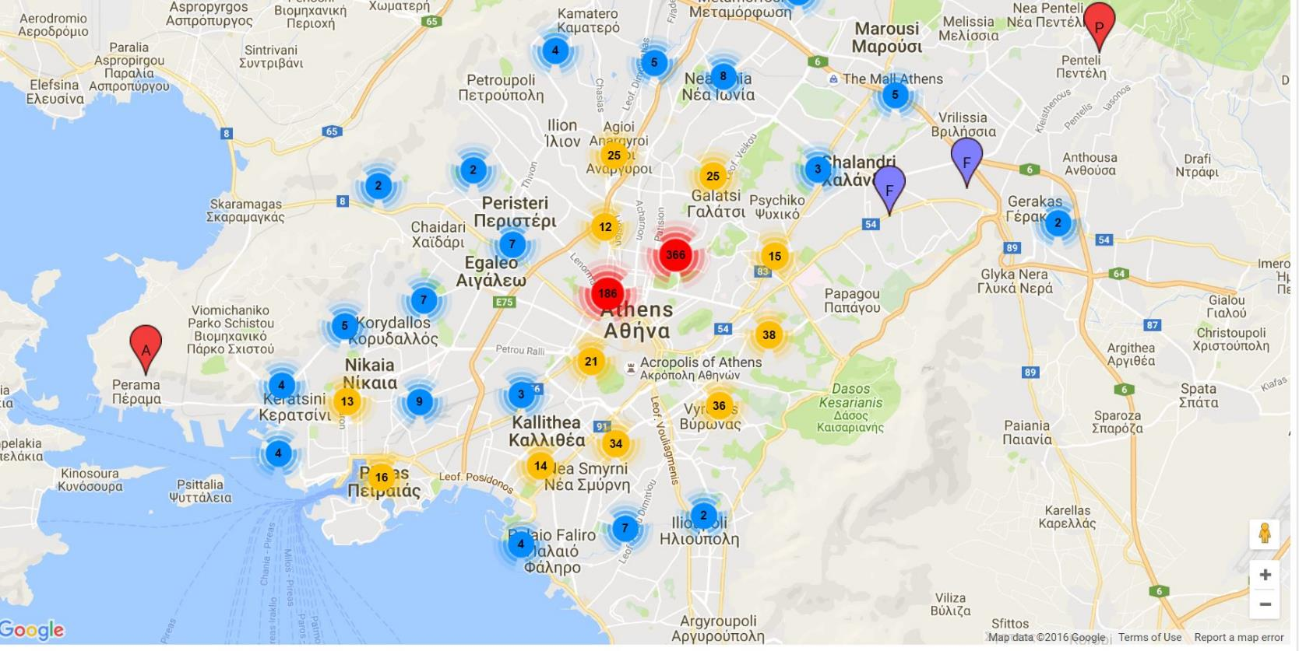
When we depend on existing systems to support the displaced.

Slide 3
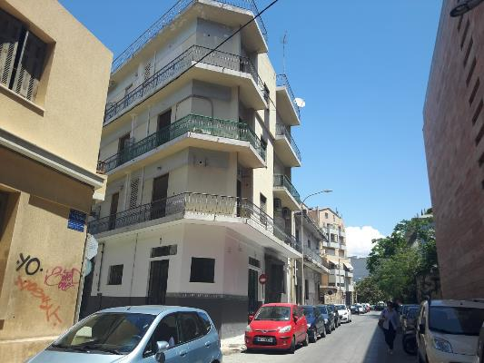
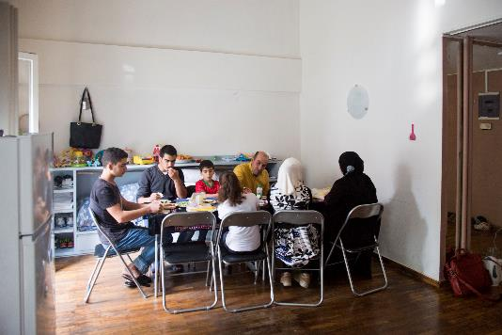
Safe, appropriate and dignified urban accommodation for migrants and refugees
Hard ware
We leasing vacant apartment buildings from private owners
We repair the apartments to a safe Greek building standard.
We furnish apartments with essential household items.
We cover utility bills (electricity, water, heating, municipal tax) and maintenance costs
We provide cash support to the refugee families which is used in the neighborhood
Soft ware;
We negotiate lease agreements with building owners
We provide social support services, case management, referrals, child and adult activities, CFS, translators
We provide security in building

Slide 4
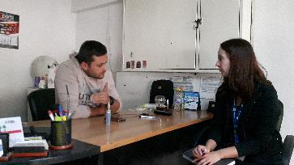
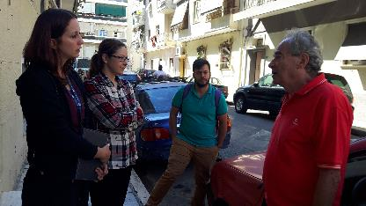
General Concerns raised towards each group
Debt
Safety
Everyone wants peaceful existence.
Is it possible to aim for peaceful co-existence?
Tax
Local Greek Residents
Poverty
Business/ employment
Education
Religion
Housing
Culture
Health
Hygiene
Over-crowding
Disease
Ghettoization
Want to be appreciated
Safety
Want to show appreciation
Safety
Established migrants
Balkans, Eastern Europe, Africa, Middle East, Asia
Religion
New arrivals
Refugees/ Migrants
Relocation -Asylum seekers
When are they leaving Greece?
What is the next country going to be like?
Jealousy towards new arrivals receiving more assistance than when they arrived
Want to be productive and give back
Work
Health
Apathy towards the new arrivals
Education
Debt
There is a wide range of attitudes towards established Migrants and New arrivals
Welcoming
Sympathy
Indifference
Rejection

Slide 5
Opening up space for positive engagement; Facilitating relationship building 1. Activities and Action based; a. Within the accommodation, b. Within the host community 2. Neighbourhood improvement contributions a. Municipal / district level b. Neighbourhood level
level | Persons / roles | Networks
Personal level | Elderly Man/ Woman, Romanian origin, African Origin, Hair dresser, Tailor, restaurant owner, Greek religious person. | Groups from former village,
Neighborhood level | Pensioners, KAPI Church
District/ Ward level | District Presidents Victoria Square services coordination | Charities and NGO’s Victoria Sq coordination District meetings
Municipality level | Vice Mayor of Civil Society Vice Mayor of Migration | Urban living working group
National level | Social Services EKA Park maintenance
International level | INGO’s/ UN

Slide 6
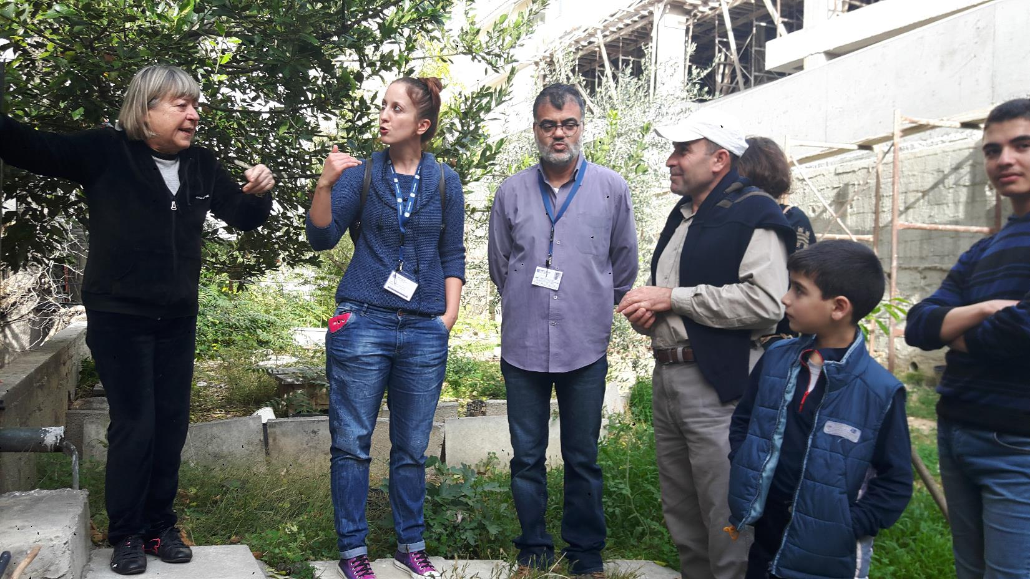

Slide 7
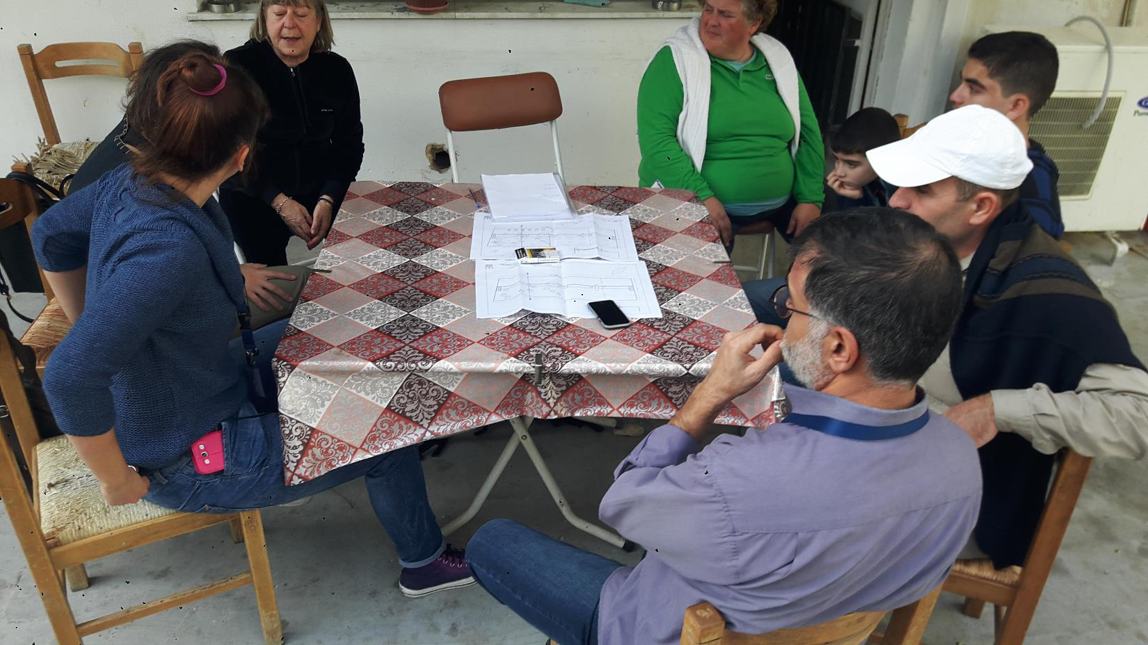

Slide 8
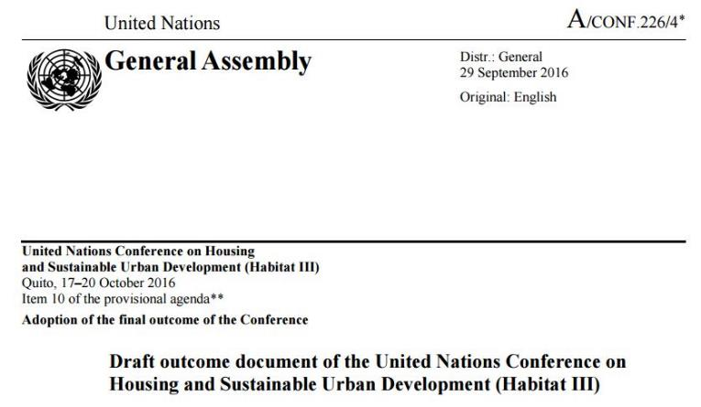
We commit ourselves to ensuring full respect for the human rights of refugees, internally displaced persons and migrants, regardless of their migration status, and support their host cities in the spirit of international cooperation, taking into account national circumstances and recognizing that, although the movement of large populations into towns and cities poses a variety of challenges, it can also bring significant social, economic and cultural contributions to urban life.
Support those countries rescuing, receiving and hosting large numbers of refugees and migrants.
Strongly condemn xenophobia against refugees and migrants and support a global campaign to counter it.
Strengthen the positive contributions made by migrants to economic and social development in their host countries.

Slide 9
What do you think of this side of programming? Psychological – Ware Emotional-Ware Social-Ware People-Ware Empathetic-Ware Emotional - Ware Mainstream it? Integrate it? Any of your experiences?
Host community support
Local community engagement
Connector projects
Social cohesion
Community liaison
Local integration
Building bridges
seki.hirano@crs.org
Protection
-Prioritize safety and dignity and avoid causing harm.
-Ensure participation and empowerment.
Peace building
Conflict analysis,
management,
sensitivity

