Slide 1
(Re)settlement Toolkit
Arup International Development
Hayley Gryc, Associate
Siddharth Nadkarny, Senior Urban Consultant
11 November 2016

Slide 2
Outline
What is the (Re)settlement Toolkit
Background
Where we are now
Next steps

Slide 3
What is the (Re)settlement Toolkit?

Slide 4
The challenge:
How do you select and plan sites appropriately to create resilient communities?
Notes:
In post-disaster contexts, there is the issue of resettling communities – for environmental hazards, land tenure reasons etc. In some cases, governments assign a piece of land, or organisations look for land, in some other cases people find their own piece of land. the challenge is how do you select appropriate land and plan sites to create resilient communities?

Slide 5
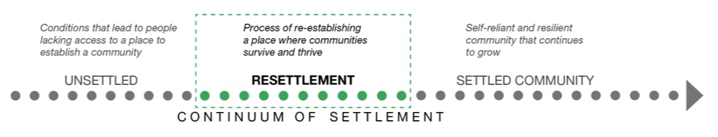
New approaches to resettlement extend beyond the provision of shelters, and emphasise the need to build resilient communities.
The (Re)settlement Toolkit provides development and humanitarian organisations with tools to select, appraise, and plan sites for unsettled people along this continuum of settlement, and create resilient communities that thrive in their new neighbourhoods.
Notes:
In post-disaster contexts, there is the issue of resettling communities. In some cases, governments assign piece of land, in some others people find their own piece of land. the challenge is how do you select appropriate land and plan sites to create resilient communities

Slide 6
Background

Slide 7
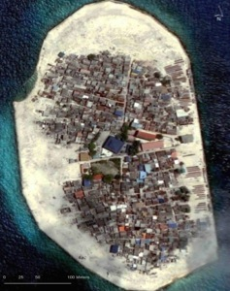
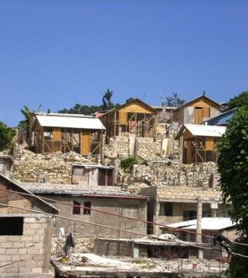

Previous experience
Site Selection
Dhuvafaaru Island Tsunami Resettlement Study, Maldives
Site Selection/Site Appraisal
Rapid Site Survey and Appraisal Checklist, Haiti
Site Planning
New Settlement Guidelines, Haiti
Notes:
Dhuvafaaru, 2012
Identified site selection indicators that covered locational and procedural factors of the resettlement process.
Developed rating system based on qualitative and quantitative evaluation of the site to communicate suitability
Rapid site survey and appraisal, 2011
Two-step checklist designed for ease of use on site: site survey guide and site appraisal guide
Site survey guide generated preliminary site assessment and helped make go/no-go decisions
Site appraisal checklist that verified site survey observations and helped determine if any additional mitigation was required
New settlement guidelines, 2011
Provided optimal and context-specific site planning guidelines, organised by discreet topics
Guidelines emphasised planning for incremental growth of the settlement

Slide 8
Where we are now

Slide 9
Roadmap
Phase 1
Today
Phase 2
January – March 2016
January – December 2017
Arup-funded
Grant funded, through partnership with development organisations
Scoping
Framework draft
Framework development
Toolkit development
Engage with development organisations
Literature review
Refine scope of toolkit
Analyse and organise resettlement guidance from Arup case studies
Develop draft toolkit framework
Identify partners with range of resettlement experience
Test draft framework validity with on-ground experience of partners
Analyse and organise guidance from partner case studies into framework
Translate framework + guidance into user-friendly site selection, appraisal and planning guides
Notes:
We are developing the resettlement toolkit in two phases: the first, an Arup funded phase where we scoped the need and developed a draft framework
Looking for partners who can help conceive and execute Phase 2, which will include framework dev and toolkit dev

Slide 10




Approach – Phase 1
Engage
Toolkit Brief
Specific areas within the resettlement process that the toolkit can contribute to
Review
Resettlement guidelines and other toolkits
Framework + Tools
Guidance on factors to consider in the resettlement process
Analyse
3 resettlement projects completed by Arup
Notes:
Toolkit brief
Provide clear, concise guidance on resettlement process
Record qualitative and quantitative information on sites
^{Compare site data to baselines}
Report site suitability through outputs
Integrate with existing best-practices handbooks and guidelines
Help in the effective allocation of skills

Slide 11
Draft framework – temporal phases
Priorities that can guide site selection, appraisal and planning of resettlement vary depending on how ‘unsettled’ a community is
Unsettled
Resettlement
Settled community
CONTINUUM OF SETTLEMENT
Emergency resettlement
e.g. post-disaster contexts
Temporary relocation
e.g. due to extended conflict
Temporary resettlement
e.g. due to redevelopment of informal settlements
Permanent relocation
e.g. due to risk from environmental factors
PHASES
Viability of settlement
Provision of basic needs
Settlement sustainability
Future Growth
Increasing independence for the resettled community
Increasing demand for services for the resettled community
Notes:
Our analysis revealed a couple of important things, one that there were many pieces of guidance to inform the site selection, appraisal and planning of resettlement sites. Two, that resettlement means a lot of different things, and the priorities that guide … vary depending on how unsettled a community is. E.g. emergency resettlement in post-disaster contexts to permanent relocation….
There seem to be four phases to consider when going from unsettled to settled, each with increasing independence for the settled community, but also increasing the services that have to be available to the resettled community. Perhaps access to recreational space may not be a priority in the viability phase, but will become one when the community is in later phases

Slide 12
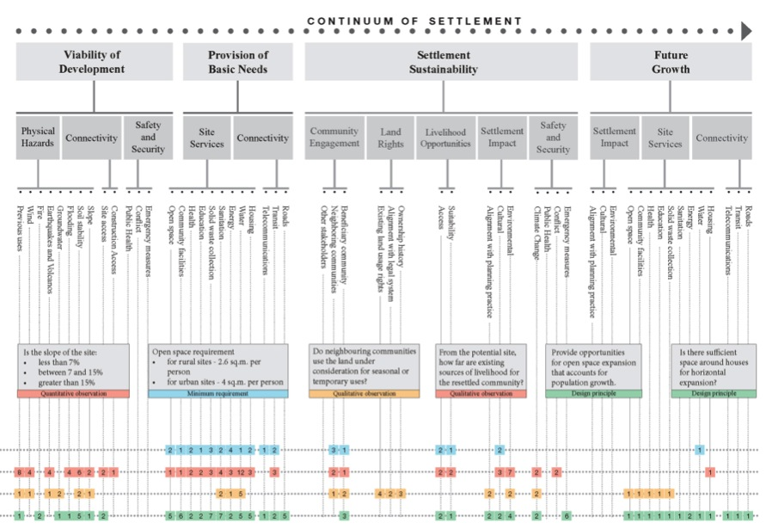
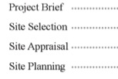
Draft framework
4 Phases
Points in time along the resettlement continuum
8 Criteria
Spatial and locational characteristics of the resettled community
38 Topics
Areas of expertise under which factors can be organised
> 250 Factors
Specific guidance for resettlement
Organise factors by applicability to selection, appraisal or planning of resettlement
4 Tools

Slide 13
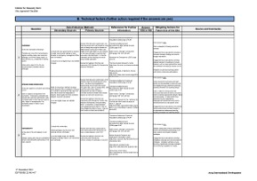
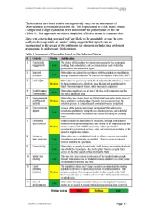
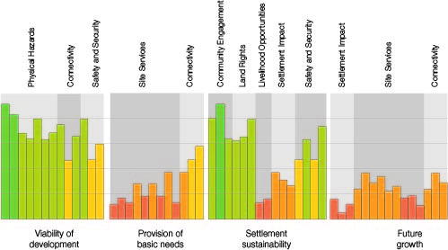
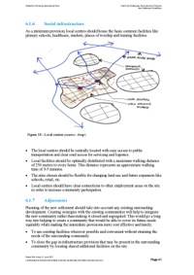
Possible toolkits
Project Guidance and Checklists
Site Suitability Evaluation Metrics

Slide 14
Next steps

Slide 15
Roadmap
Phase 1
Today
Phase 2
January – March 2016
January – December 2017
Arup-funded
Grant funded, through partnership with development organisations
Scoping
Framework draft
Framework development
Toolkit development
Engage with development organisations
Literature review
Refine scope of toolkit
Analyse and organise resettlement guidance from Arup case studies
Develop draft toolkit framework
Identify partners with range of resettlement experience
Jointly apply for grant funding for further development
Test draft framework validity with on-ground experience of partners
Analyse and organise guidance from partner case studies into framework
Translate framework + guidance into user-friendly site selection, appraisal and planning toolkits

Slide 16
Test framework
Partner with us
Test draft framework validity with on-ground experience of partners
Analyse and organise guidance from partner case studies into framework
Develop toolkits
Based on partner need, develop tools and guides
Apply for funding
Jointly apply for grant funding for further development, such as HIF

Slide 17
For more information
Siddharth Nadkarny
siddharth.nadkarny@arup.com
Notes:
On flyer put Jo and SN (PD, PM) as contacts

