Slide 1
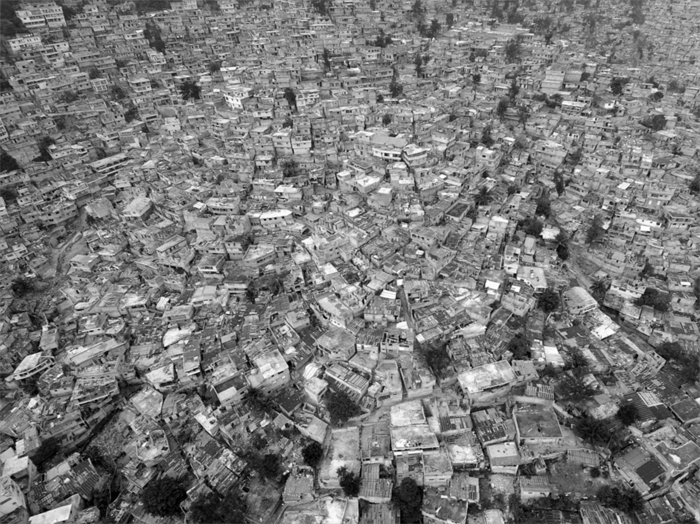
“settlement”
“neighbourhood”
“integrated”
Area-based approaches
to urban humanitarian crises
“community-based”
“district”

Slide 2
What are area-based approaches to urban humanitarian crises?
Why are they being adopted?
What are the consequences?
How can they be improved?

