Slide 1

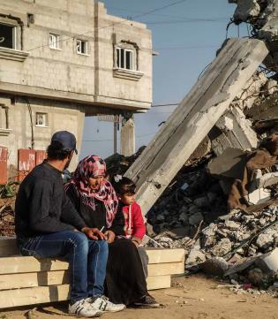



UK Shelter Forum
24th April 2015 AGENDA
09:00-09:30 | Welcome coffee
09:30 - 09:40 | Opening remarks & House keeping Jake Zarins - Habitat for Humanity Jamie Richardson - Catholic Relief Services John Twigg/Kate Crawford- University College London
09:40 -10:30 | Updates (10 mins each): Vanuatu response - Bill Flinn CARE Community Based Safe School Construction - Hayley Gryc Arup Global Shelter Cluster online training – Charles Parrack Oxford Brookes Expanding Impact - Seki Hirano CRS Capacity building for urban humanitarian response – Diane Archer, IIED
10:30 -10:50 | Adverts for sessions (5 mins each) Area based approaches to urban crises – Elizabeth Parker and Victoria Maynard Disaster diplomacy; Reconstruction Planning Before a Disaster - Ilan Kelman UCL Protection Mainstreaming - Cat Cowley CAFOD, Caritas Australia, Catholic Relief Services, and Trocaire Development of the ‘Refugee Housing Unit ‘ – learning from the process - Shaun Scales UNHCR
10:50 -11:15 | Coffee /Tea (25 mins)
11:15 - 12:00 | Discussion Sessions A,B ,C,D (45 mins )
12:00 – 12:30 | Report out
12:30 – 13:30 | Lunch (1h)
13:30 - 15:00 | Talks (15 mins each): Urban Tripoli in Lebanon and in Kirkuk in Iraq – Amelia Rule CARE Community-led settlement planning - Annika Grafweg The Border Consortium All Under One Roof – Valerie Scherrer CBM & Graham Saunders IFRC Shelter case studies - Joseph Ashmore IOM Engaging Humanitarians and Non-humanitarian Actors in Urban Emergency Response - Eddie Argenal USAID Developing resilient habitats after a disaster - Jan-Willem Wegdam Cordaid
15:00 - 15:30 | Coffee/Tea (30 mins )
15:30 - 16:15 | Q&A on the new ECHO Shelter Policy - Matthew Sayer facilitated by Tom Newby (45 mins)
16:15 - 16:45 | Updates and AOB India Shelter Forum – Anshu Sharma Interaction – Hilmi Mohamed RedR’s Hands on Weekend – Aaron Walawalkar QSAND – Yetunde Abdul BRE
17:00 – 18:00 | Pechakucha (7 mins each) "Sustainable and seismically-resistant permanent low-cost housing in Latin America" - Sebatian Kamninski Arup Rental practices in two informal settlements in Hyderabad, India - Nikhilesh Sinha UCL Reciproboo Bamboo Kit - Shaun Halbert Positioning children in emergency relief. - Laura Antona UCL Cash and Costs in Context: T-Shelter and recovery in Japan – Kate Crawford, UCL
Venue:
Room G04
Chadwick Building,
University College London
Gower Street
London WC1E 6BT
UK
The UK Shelter Forum will be held in the Chadwick Building at University College London. Once you enter through the main gate of University College London (on Gower Street) the Chadwick Building is to your immediate right. The nearest tube stations are Euston Square or Warren Street and both are within 5 minutes’ walk.

